Slide 1


Microsoft SQL Server

Slide 2
Class Outline
Database Basics
Installation and Setup
Working with SQL Server
Retrieving, Sorting, Filtering, and Manipulating Data
Joining Tables
Inserting, Updating, and Deleting Data
Users and Backups

Slide 3

Database Basics
What is a database?
A container created to store organized data.
Usually, a file or set of files.

Slide 4
Database Basics
What is Microsoft SQL Server?
Database software that is used to access the database files.
Microsoft SQL Server is a Database Management System (or DBMS).

Slide 5
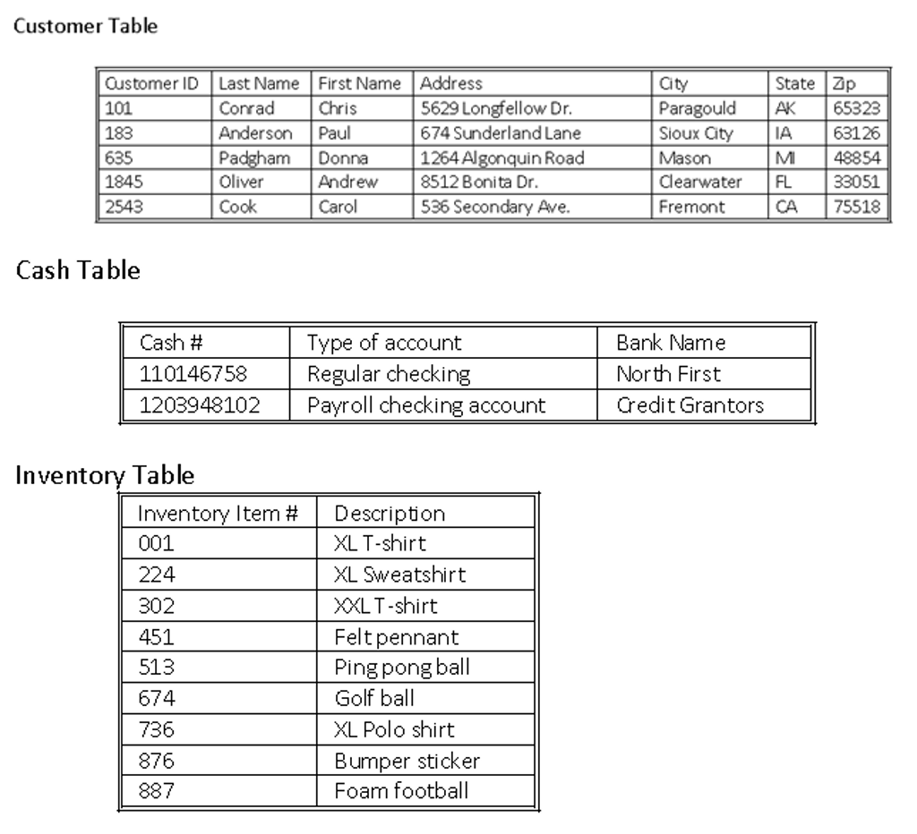
Database Basics
What is a table?
A table is a structured file that can store data of a specific type.
A table might contain a list of customers, a product catalog, or any other list of information.
The data stored in the table is one type of data or one list.
You would never store a list of customers and a list of orders in the same database table.

Slide 6
Database Basics
Tables
Every table has a name.
Every database and table has a schema.
  Schema defines database and table characteristics and how data is store.
Every table has columns.
  Each column contains a particular piece of information.
  Customer ID, Last Name, First Name, Address, City, State, Zip
  Each column is allowed a only certain type of data or datatype.

Slide 7
Database Basics
Tables
Every table has rows.
  A row is a record in a table.
Every table has a primary key.
  A primary key is a column (or set of columns) whose values uniquely identify each row in a table.

Slide 8
Database Basics
Tables
Primary key rules.
  No two rows can have the same primary key value.
  Every row must have a primary key value (primary key columns may not allow NULL values).
Primary key best practices.
  Don’t update values in primary key columns.
  Don’t reuse values in primary key columns.
  Don’t use values that might change in primary key columns.
  (For example, when you use a name as a primary key to identify a supplier, you would have to change the primary key when the supplier merges and changes its name.)

Slide 9
What is SQL?
SQL (S-Q-L or sequel)
SQL is a language designed specifically for communicating with databases.
SQL is not a proprietary language used by specific database vendors.
SQL is easy to learn. The statements are all made up of descriptive English words, and there aren’t that many of them.
SQL is a very powerful language, and by learning to use its language elements you can perform very complex and sophisticated database operations.

Slide 10

Microsoft SQL Server
Microsoft SQL
Basics of a SQL server
  Relational database management system
  Key components
    Database engine
    SQL Server
    SQL Server Agent
    SQL Server Browser
    SQL Server Full-Text Search
    SQL Server VSS Writer
    SQL Server Analysis Services
    SQL Server Reporting Services
    SQL Server Integration Services
Notes:
SME
Possible additional topics: editions, using Server Setup, installation, database functions (Create, Alter, Drop, Restore, Pivot)
What level of detail on each of these bulleted items is needed?
Identify general usage of each bulleted item and classify in larger groups (management, analysis and reporting, etc.)

Slide 11
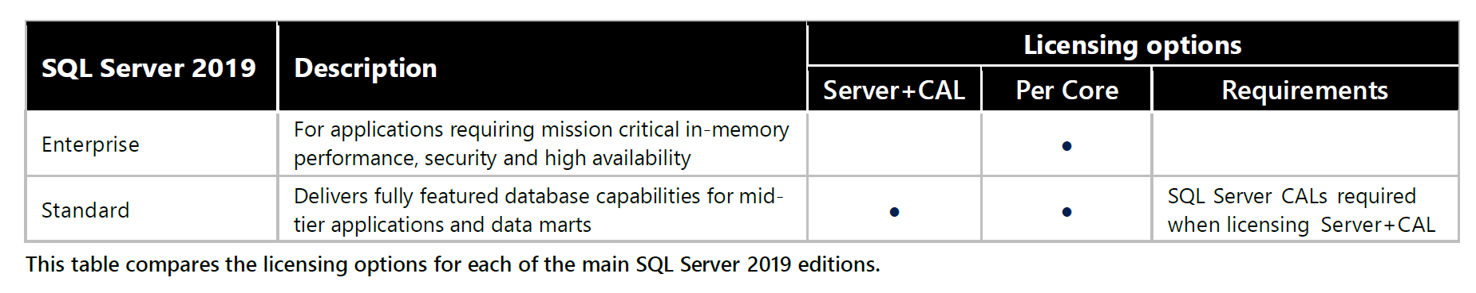
Microsoft SQL Server Licensing
Enterprise licenses are purchased based on CPU cores needed
Standard licenses are purchased per server, per core, and client access licenses (CAL’s) are required for either devices or users
https://download.microsoft.com/download/e/2/9/e29a9331-965d-4faa-bd2e-7c1db7cd8348/SQL_Server_2019_Licensing_guide.pdf

Slide 12
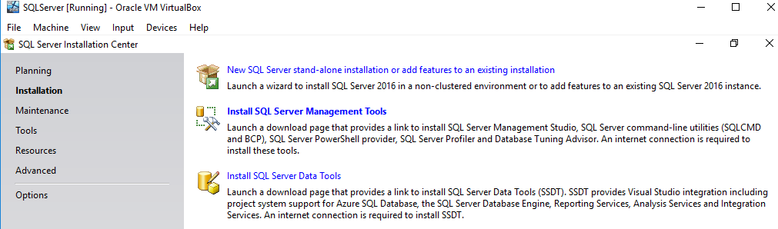
SQL Server Installation
Add the SQL Server Installation media to the physical (DVD) or virtual drive (ISO file)
Run the installation setup command. Click Next to the Installation screen
Select “New SQL Server stand-alone installation or add features to an existing installation”

Slide 13
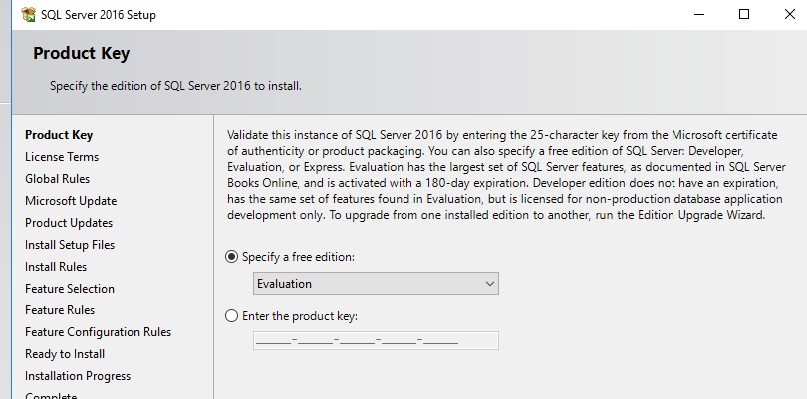
SQL Server Installation
On the SQL Server 2016 Setup screen, simply click “Next” to use the Evaluation license…

Slide 14
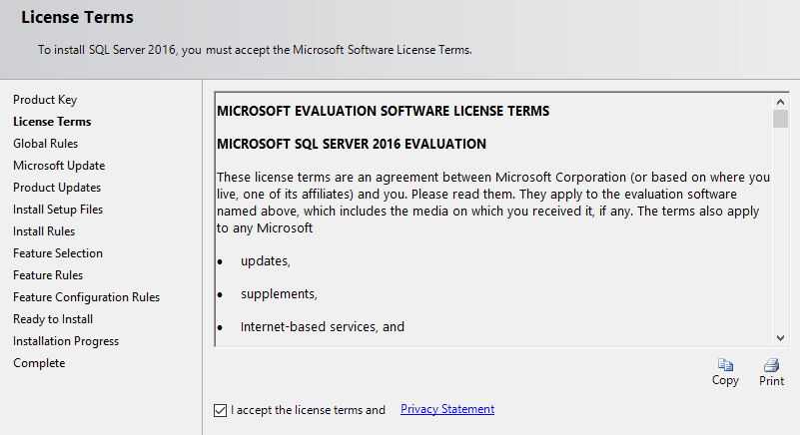
SQL Server Installation
Agree to the License agreement to continue installation… Click “Next”

Slide 15
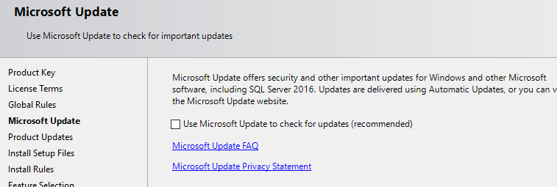
SQL Server Installation
On a real installation, select “Use Microsoft Update…” to get the latest updates. For class purposes, leave deselected.

Slide 16
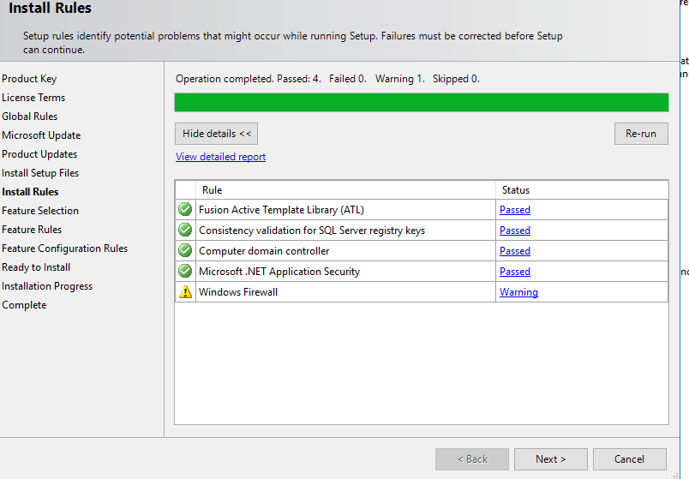
SQL Server Installation
The Install Rules process will confirm installation compatibility with this server.
If all passes, Click “Next”

Slide 17
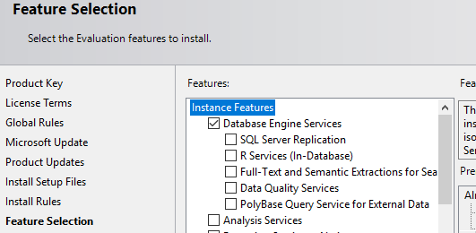
SQL Server Installation
in the Feature Selection step, Select “Database Engine Services,” then click “Next”

Slide 18
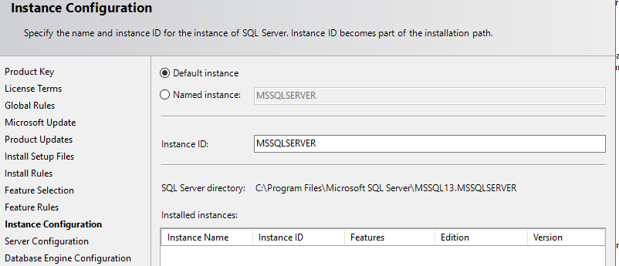
SQL Server Installation
Continue Clicking “Next” until the Instance Configuration step. In case of a first installation, enter the Instance ID. A good idea is to change the default values (MSSQLSERVER) to the organization’s naming convention
Click Next

Slide 19
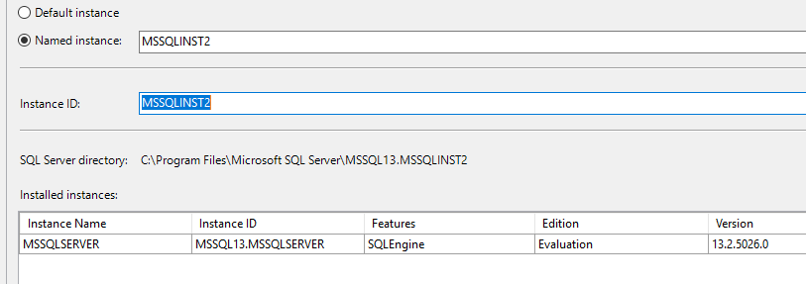
SQL Server Installation
In case that this is not the first installation, then do select another Instance name for this installation.
Follow your naming conventions.

Slide 20
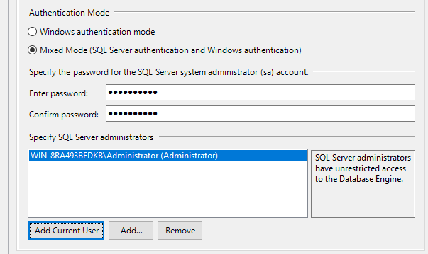
SQL Server Installation
In the Authentication Mode screen, select “Mixed Mode” and use both the SQL server accounts and the AD accounts. Provide a password for the “sa” account. For AD accounts, those already have a password.
Click “Next”

Slide 21
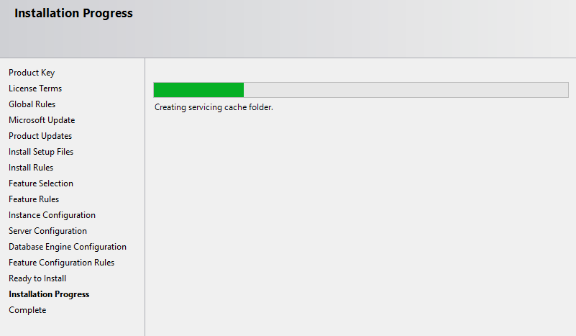
SQL Server Installation
Keep on clicking “Next” to the default values until the “Ready to Install” screen.
At this point, review the installation selections.
Click Install and watch the installation bar...

Slide 22
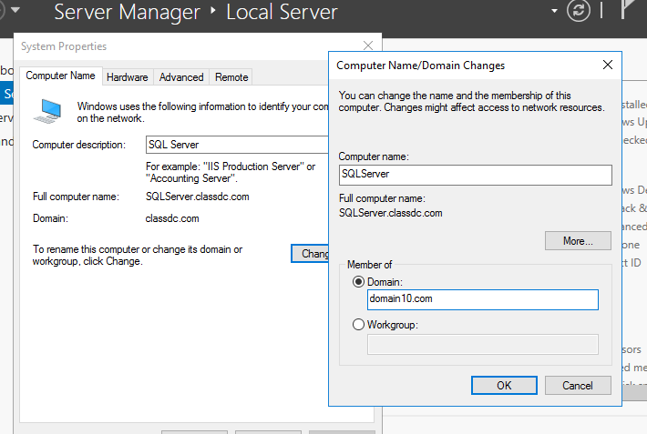
SQL Server Installation
After the installation has completed and the server rebooted, Join this server computer as a member server to the domain.
Reboot.

Slide 23
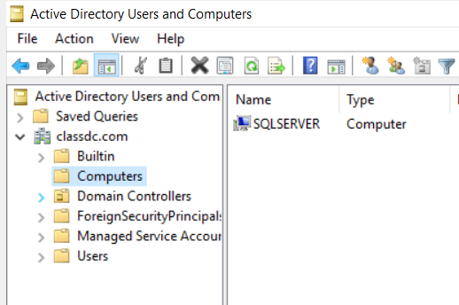
SQL Server Installation
In the Domain Controller, In “Active Directory Users and Computers” confirm that there is a new computer in the “Computers” folder: SQLSERVER
Now, it’s easier to enforce security authentication and authorization rules.

Slide 24
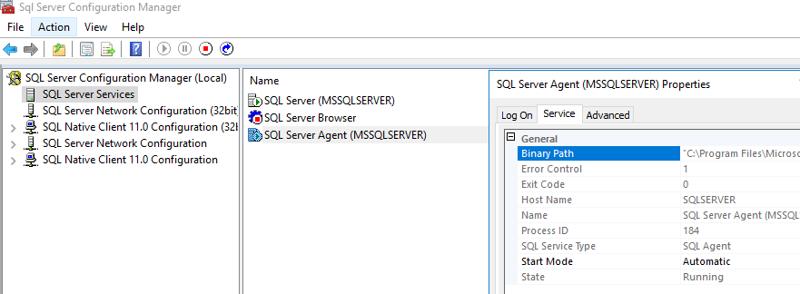
SQL Server Installation
After the SQL Server has finished rebooting and is part of the Domain, Look for SQL Server Configuration Manager and start it.
Then, in SQL Services, Right-Click SQL Server Agent. Click on the Service tab and configure it for Automatic start then, Start the Service.

Slide 25
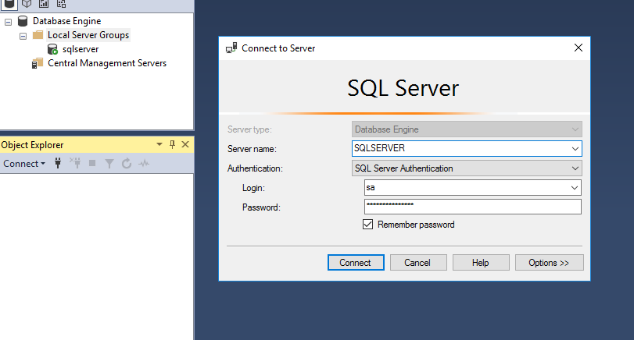
SQL Server Installation
Look for SQL Server Management Studio and start it.
In the Object Explorer, Click on Connect.
The Login Dialog shows up
Login with the sa account, for
which we gave it a password.
The Server name is defaulted to
SQLServer, or look in the
Registered Servers dialog, under
Database Engine, Local Server
Groups…
Connect

Slide 26
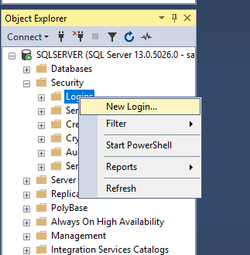
SQL Server Installation
Allow for other logins:
From the Security object, Right-Click on Logins, Select “New Login”

Slide 27
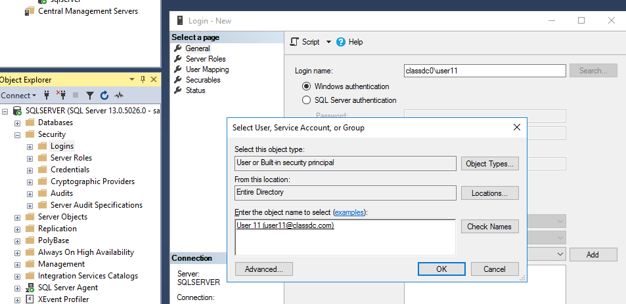
SQL Server Installation
In the Login Dialog, enter a login name from the domain, Click on Search
In the Select User dialog, click on Locations,
Select Entire Directory
Back to the Select User dialog, enter the user name to authorize, (user11) and click on Check Names
Once the user account has validated, Click OK

Slide 28
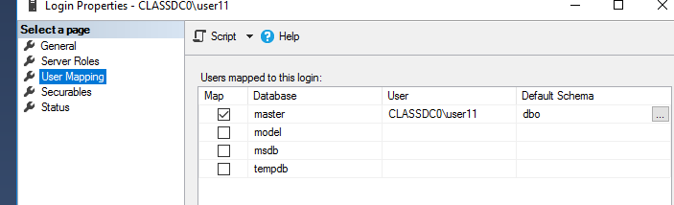
SQL Server Installation
Back to the Login Properties dialog,
Click on User Mapping
Select the Default “master” database
The user’s account will populate to the right
Further right, under Default Schema, if it doesn’t enter the default option “dbo” (database owner), then type it.

Slide 29
The “sa” Account
Normally, DBAs prefer to login with the “sa” or system administrator account.
That is a default behavior from the days when they took the SQL class, which defaults to the time when SQL Server was usually installed outside of a Microsoft Active Directory Network (before it, really), in the 1990s…
We prefer to use Active Directory accounts for better accountability and authentication/authorization.

Slide 30
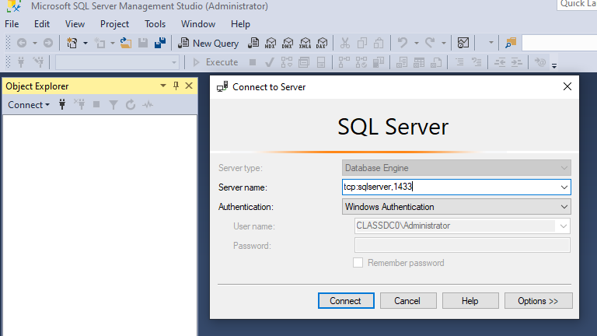
Other Administrative Accounts (Security)
So, after having allowed for other Active Directory accounts, one can now use those accounts to more safely administer the SQL Server environment
Logging in from a device other than the SQL server requires opening ports in host and network firewalls, from the standard 1433 to other registered ports specific to a given database.

Slide 31
Lab 1 – Installing SQL Server and Mgmt Studio

Slide 32
Lab 1.1 and 1.2 – Install Lab Files

Slide 33
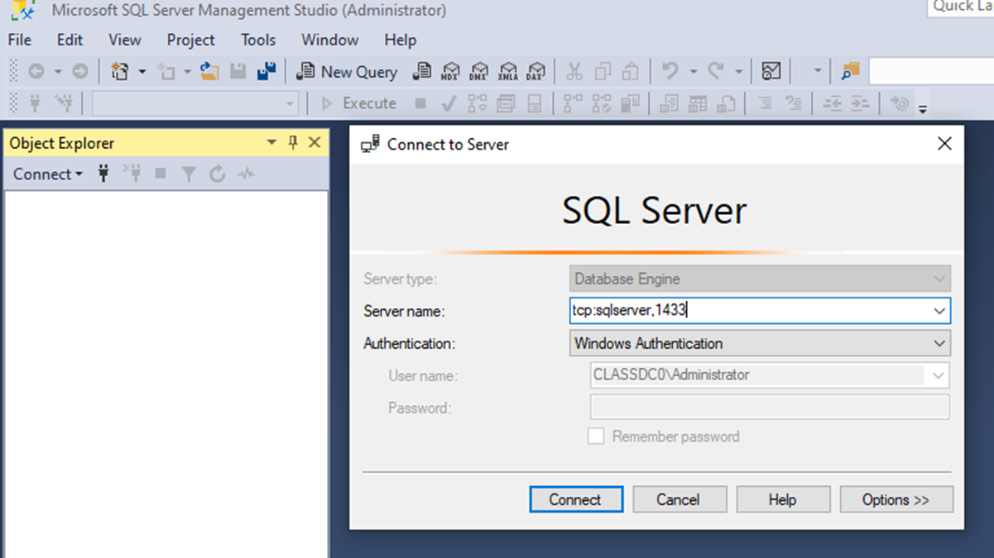
Connecting to a Remote Database
Enable remote connections on the SQL server.
  Connect locally using SSMS.
  Right click the server and choose Properties.
  Click Connections
  Check the box to allow remote connections.
Make sure ports 1433 and 1434 are open in the ACL.
Open SSMS.
Enter the server's name.
Choose Windows authentication.

Slide 34
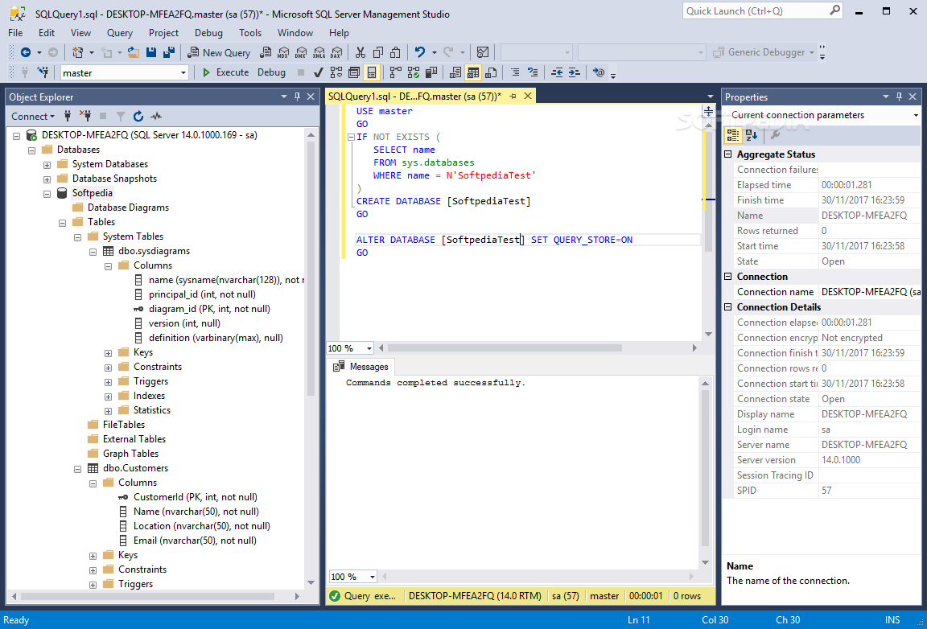
SQL Server Management Studio
Top screen – Toolbar
Left column – Object Explorer
Right column – Properties Panel
Top left – New Query
F5 or CTRL+E executes a query
Bottom center – Results of query
Bottom of screen – Status messages

Slide 35
Selecting a Database
USE <database name>;
sp_tables;
sp_columns;
sp_server_info;
sp_spaceused;
sp_statistics;
sp_helpuser;
sp_helplogins;

Slide 36
Retrieving Data - SELECT
The SELECT statement is used to retrieve rows and columns of data from one or more existing tables.
A simple SELECT returns all the rows in a table.
Data is not filtered or sorted.
Retrieve all columns with *.
SQL statements are not case sensitive.
SELECT column1, column2, ... columnN
FROM table_name;

Slide 37
Retrieving Data – DISTINCT and TOP
SELECT DISTINCT column_name FROM table_name;
The SELECT DISTINCT clause allows you to retrieve only unique values from a specified column in a table.
The TOP clause allows you to limit the number of rows returned in a query result set.
SELECT DISTINCT column_name
FROM table_name;
Retrieve a specific number of rows
SELECT TOP N column1, column2, ...
FROM table_name;
Get a percentage of rows.
SELECT TOP N PERCENT column1, column2, ...
FROM table_name;

Slide 38
Sorting and Retrieving Data – ORDER BY
SELECT DISTINCT column_name FROM table_name;
The ORDER BY clause is used to sort the result set of a SELECT statement in a specified order. It allows you to sort the rows returned by a query based on one or more columns.
ASC: Ascending order (default if not specified).
DESC: Descending order.
SELECT column1, column2, ...
FROM table_name
ORDER BY column1 [ASC|DESC], column2 [ASC|DESC], ...;
Caution: Position of the ORDER BY Clause.
When specifying an ORDER BY clause, be sure that it is after the FROM clause. Using clauses out of order generates an error message.

Slide 39
Filtering Data - WHERE
SELECT DISTINCT column_name FROM table_name;
The WHERE clause is a powerful tool for filtering data in your queries.
SELECT column1, column2, ...
FROM table_name
WHERE condition;
Finding rows with a specific value:
SELECT EmployeeKey, LastName
FROM DimEmployee
WHERE LastName = 'Smith’;
Using pattern matching:
SELECT EmployeeKey, LastName
FROM DimEmployee
WHERE LastName LIKE '%Smi%’;
Applying comparison operators:
SELECT EmployeeKey, LastName
FROM DimEmployee
WHERE EmployeeKey <= 500;
Combining multiple conditions:
SELECT EmployeeKey, LastName
FROM DimEmployee
WHERE EmployeeKey = 1 OR EmployeeKey = 8 OR EmployeeKey = 12;
Complex conditions:
SELECT EmployeeKey, LastName
FROM DimEmployee
WHERE EmployeeKey <= 500 AND LastName LIKE '%Smi%' AND FirstName LIKE '%A%’;
Filtering a list of values:
SELECT EmployeeKey, LastName
FROM DimEmployee
WHERE LastName IN ('Smith', 'Godfrey', 'Johnson');

Slide 40
Using Wildcard Filtering - LIKE
SELECT DISTINCT column_name FROM table_name;
The LIKE clause allows you to search for specific patterns within a column.
Tips for using wildcards.
  Don’t overuse wildcards. If another search operator will do, use it instead.
  When you do use wildcards, try to not use them at the beginning of the search pattern unless necessary. Search patterns that begin with wildcards are the slowest to process.
  Pay careful attention to the placement of the wildcard symbols. If they are misplaced, you might not return the data you intended.
Percent Sign (%):
  Represents zero, one, or multiple characters.
  Example: LIKE '%abc%' matches any value containing “abc.”
Underscore (_):
  Represents a single character.
  Example: LIKE '_x' matches values like “ax,” “bx,” but not “xyz.”
Brackets ([]):
  Encloses a list of characters to match.
  Example: LIKE '[a-c]%' matches values starting with “a,” “b,” or “c.”
Character Range ([a-z]):
  Specifies a range of characters.
  Example: LIKE '[A-Z]%' matches values starting with an uppercase letter.

Slide 41
Lab 2 – Retrieving, Sorting, and Filtering Data

Slide 42
Grouping Data – GROUP BY
SELECT DISTINCT column_name FROM table_name;
The GROUP BY clause in SQL Server is a powerful tool that allows you to divide query results into groups of rows based on one or more columns.
SELECT column1, column2, ...
FROM table_name
GROUP BY column1, column2, ...;
Example:
SELECT region, SUM(sales_amount) AS total_sales
FROM sales
GROUP BY region;

Slide 43
Summarizing Data - AGGREGATE
SELECT DISTINCT column_name FROM table_name;
Aggregate functions operate on a group of values and return a single result. They are often used with the GROUP BY clause to summarize data.
MIN(): Returns the smallest value within the selected column.
MAX(): Returns the largest value within the selected column.
COUNT(): Returns the number of rows in a set.
SUM(): Returns the total sum of a numerical column.
AVG(): Computes the average value of a numerical column.
Remember that aggregate functions ignore null values (except for COUNT(*))

Slide 44
Lab 3 – Grouping and Summarizing Data

Slide 45
Working with Subqueries
SELECT DISTINCT column_name FROM table_name;
A subquery in SQL Server, also known as an inner query, is a query nested inside another query or statement. It can be used with SELECT, INSERT, UPDATE, or DELETE statements.
SQL server supports up to 32 levels of nesting for subqueries.
SELECT column1
FROM table1
WHERE column2 = (SELECT MAX(column2) FROM table2);

Slide 46
Lab 4 – Working with Subqueries

Slide 47
Joining Tables - JOIN
SELECT DISTINCT column_name FROM table_name;
The JOIN clause combines data from two or more tables into a single dataset based on a specified condition.
SELECT column1
FROM table1
WHERE column2 = (SELECT MAX(column2) FROM table2);

Slide 48
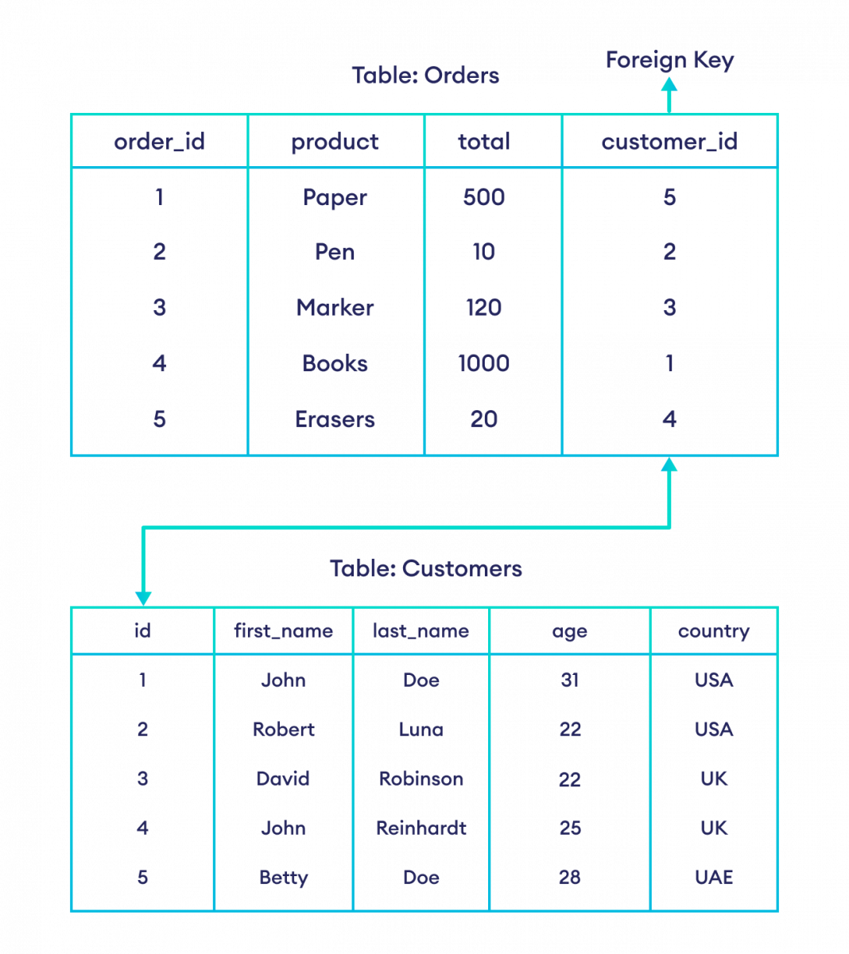
Joining Tables – Foreign Keys
SELECT DISTINCT column_name FROM table_name;
A foreign key in SQL Server establishes a referential link between two tables.
Example:
  Suppose we have an Orders table with an Customer_ID column as a foreign key referencing the Customers table’s primary key.
  This link ensures that an order can only be associated with an existing customer.

Slide 49
Joining Tables – Creating a Join
SELECT DISTINCT column_name FROM table_name;
To create a join, you must specify all the tables to be included and how they are related to each other.
Joining multiple tables by specifying all the tables and the relationships between them.
Inner Join:
SELECT vend_name, prod_name, prod_price
FROM vendors, products
WHERE vendors.vend_id = products.vend_id
ORDER BY vend_name, prod_name;
Multiple table join:
SELECT prod_name, vend_name, prod_price, quantity
FROM orderitems, products, vendors
WHERE products.vend_id = vendors.vend_id
AND orderitems.prod_id = products.prod_id
AND order_num = 20005;

Slide 50
Lab 5 – Joining Tables

Slide 51
Full Text Searching
SELECT DISTINCT column_name FROM table_name;
Enabling full text searching:
  EXEC sp_fulltext_database 'enable’;:
Creating a full text catalog:
  CREATE FULLTEXT CATALOG catalog_learnsql;
Use the CONTAINS or FREETEXT operators in the query.
Freetext:
USE AdventureWorks2022;
SELECT Title
FROM Production.Document
WHERE FREETEXT(Document, 'vital safety components’);
Contains:
SELECT *
FROM Product
WHERE CONTAINS(ProductName, 'apple');

Slide 52
Inserting Data - INSERT
SELECT DISTINCT column_name FROM table_name;
The INSERT INTO statement in SQL Server allows you to add new records to a table.
Multiple rows can also be inserted.
Specify both column names and values:
INSERT INTO table_name (column1, column2, column3, ...)
VALUES (value1, value2, value3, ...);
INSERT INTO Customers (CustomerName, ContactName, Address, City, PostalCode, Country)
VALUES ('Cardinal', 'Tom B. Erichsen', 'Skagen 21', 'Stavanger', '4006', 'Norway');

Slide 53
Updating Data - UPDATE
SELECT DISTINCT column_name FROM table_name;
The UPDATE statement in SQL Server modifies existing records within a table.
UPDATE table_name
SET column1 = value1, column2 = value2, ...
WHERE condition;
table_name: The name of the table you want to update.
column1, column2, etc.: Columns to modify.
value1, value2, etc.: New values for the specified columns.
WHERE condition: Determines which records to update.
Example:
UPDATE customers
SET cust_email = 'elmer@fudd.com'
WHERE cust_id = 10005;

Slide 54
Deleting Data - DELETE
SELECT DISTINCT column_name FROM table_name;
The DELETE statement in SQL Server removes one or more rows from a table.
The DELETE statement deletes rows from tables, even all rows from tables. But DELETE never deletes the table itself.
DELETE FROM table_name
WHERE condition;
Example:
DELETE FROM customers
WHERE cust_id = 10006;

Slide 55
Lab 6 – Updating and Deleting Data

Slide 56
Creating Tables – CREATE TABLE
SELECT DISTINCT column_name FROM table_name;
CREATE TABLE table_name
(
column1 data_type,
column2 data_type,
...
);
Example:
CREATE TABLE customers
(
cust_id INT NOT NULL IDENTITY(1,1),
cust_name NCHAR(50) NOT NULL ,
cust_address NCHAR(50) NULL ,
cust_city NCHAR(50) NULL ,
cust_state NCHAR(5) NULL ,
cust_zip NCHAR(10) NULL ,
cust_country NCHAR(50) NULL ,
cust_contact NCHAR(50) NULL ,
cust_email NCHAR(255) NULL ,
PRIMARY KEY (cust_id)
);
To create a new table in SQL Server, you can use the CREATE TABLE statement.
To alter the schema of a table use the ALTER TABLE command.
  Example:
  ALTER TABLE vendors
  ADD vend_phone CHAR(20);
  ALTER TABLE vendors
  DROP COLUMN vend_phone;

Slide 57
Renaming Tables
SELECT DISTINCT column_name FROM table_name;
To rename a table in SQL Server, you can use the sp_rename command.
EXEC sp_rename 'schema.old_table_name', 'new_table_name’;
Example:
EXEC sp_rename 'customers2', 'customers';

Slide 58
Managing Access Rights
SELECT DISTINCT column_name FROM table_name;
To create a new user login, use the CREATE LOGIN statement.
To set access rights, use the GRANT statement.
To revoke access rights, use the REVOKE statement.
Example CREATE LOGIN:
CREATE LOGIN BenF WITH PASSWORD = 'P@$$w0rd’;
Example GRANT:
GRANT CREATE TABLE TO BenF;
Example REVOKE:
REVOKE CREATE TABLE FROM BenF;

Slide 59
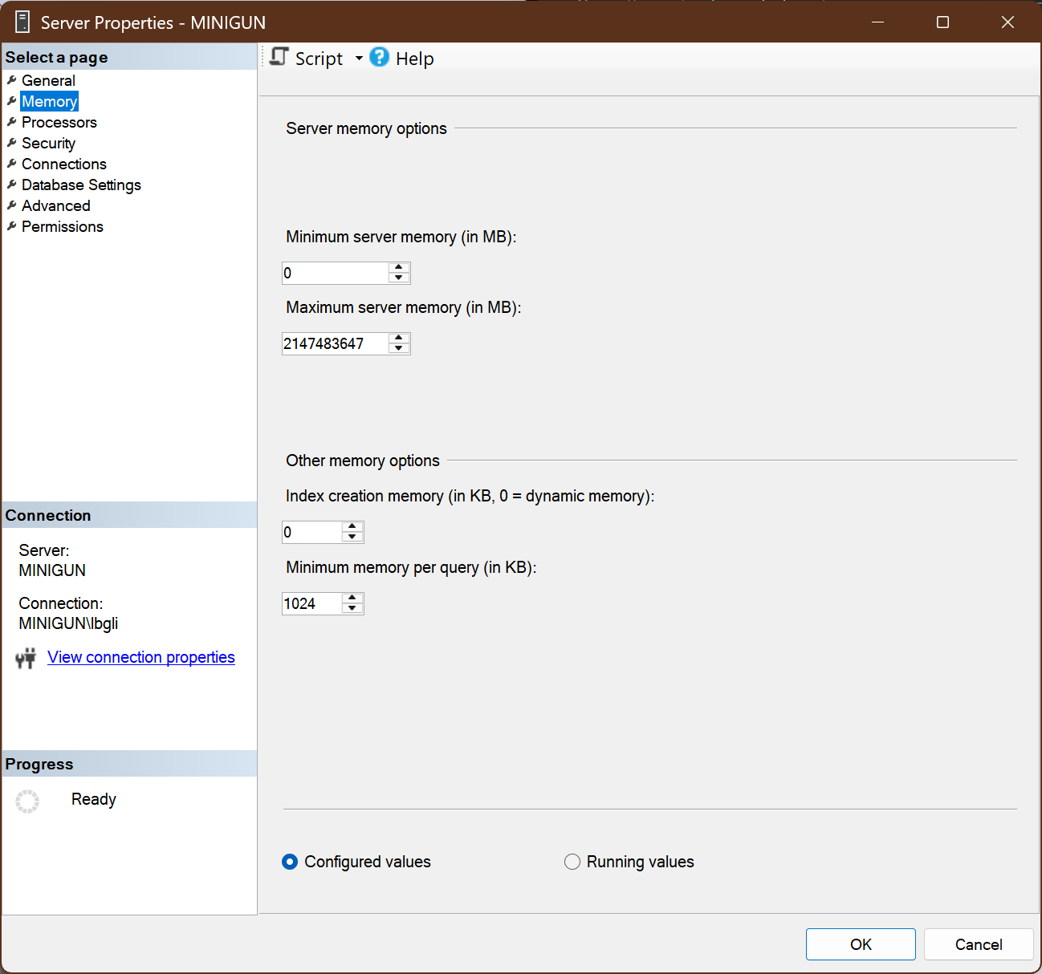
Allocating Memory
SELECT DISTINCT column_name FROM table_name;
Insufficient memory can cause intermittent problems and even corrupt data within the DBMS instance.
Right click the server's name in Object Explorer.
Click Properties.
Click Memory.
Change the value in Maximum server memory.

Slide 60
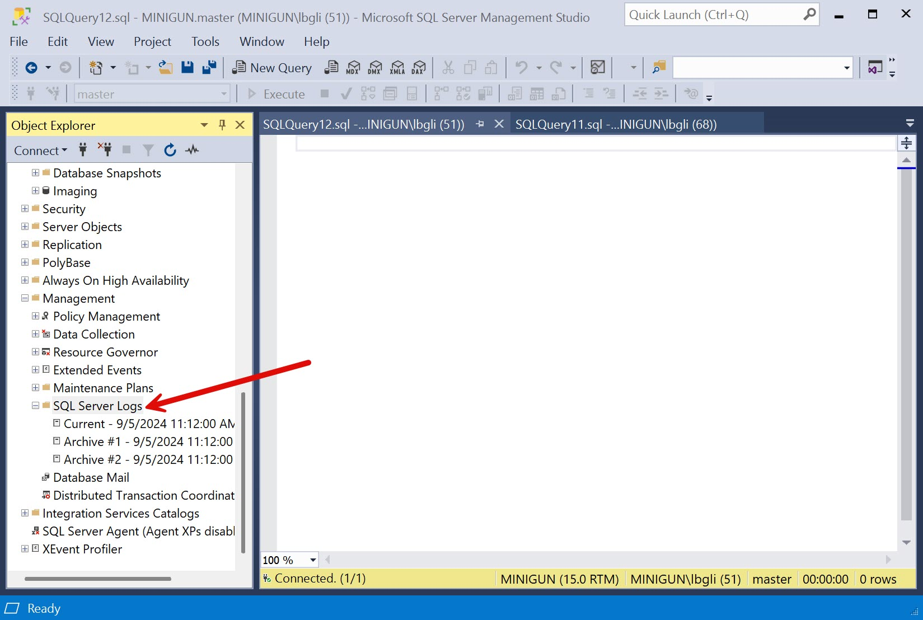
Viewing Log Files
SELECT DISTINCT column_name FROM table_name;
In Object Explorer click Management.
Right click SQL Server Logs to configure the logs.
Double-click a log to view it.

Slide 61
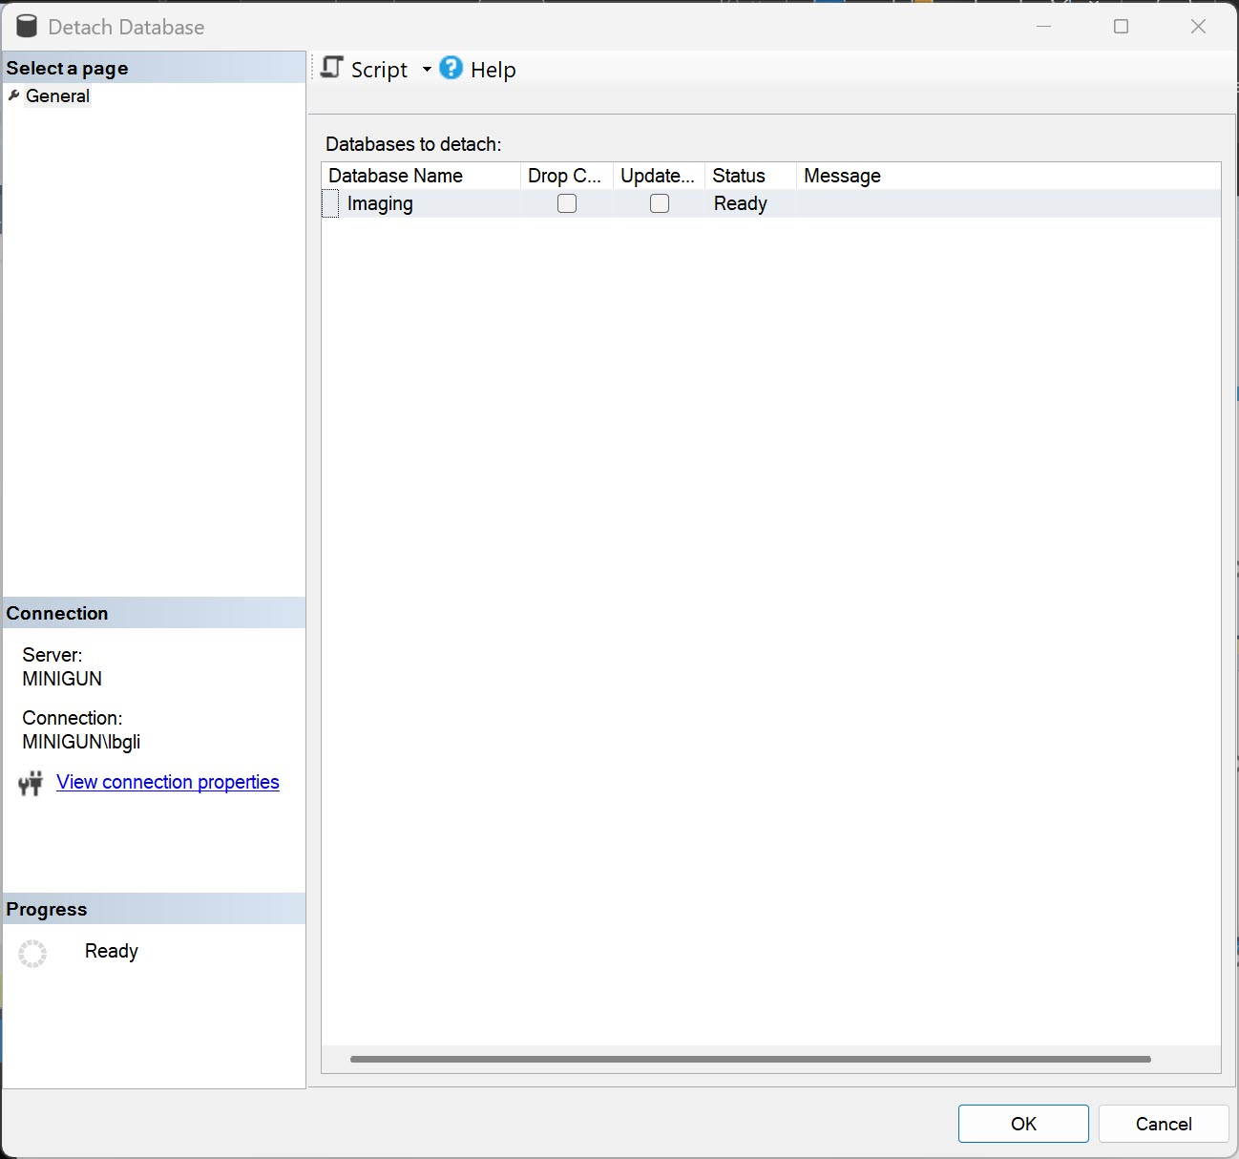
Detaching a Database
SELECT DISTINCT column_name FROM table_name;
Detach the Database
In Object Explorer, expand the Databases node.
Right-click the database you want to move, select Tasks, and then select Detach.
In the Detach Database dialog box, check the box for Drop Connections to ensure no active connections to the database, and then click OK.
Locate the database files (typically .mdf and .ldf files) on your server. These files are usually found in the SQL Server data directory.
The default location for the database files is:
C:\program files\Microsoft SQL Server\MSSQL15.MSSQLSERVER\MSSQL\DATA

Slide 62
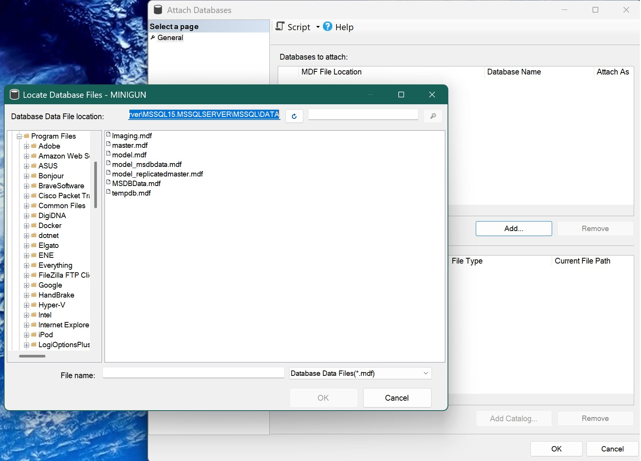
Attaching a Database
SELECT DISTINCT column_name FROM table_name;
Attach the Database on the New Server
Copy the .mdf and .ldf files to the desired location on the new server. You can use Windows Explorer or a command-line tool to copy the files.
Open SSMS and connect to the SQL Server instance on the new server.
In Object Explorer, right-click the Databases node and select Attach.
In the Attach Databases dialog box, click Add and navigate to the location where you copied the .mdf file.
Select the .mdf file and click OK. The .ldf file should be automatically detected. If not, you can manually specify its location.
Click OK to attach the database.

Slide 63
Backing Up a Database
SELECT DISTINCT column_name FROM table_name;
Using SQL Server Management Studio (SSMS):
Open SSMS.
Expand the “Databases” folder and select the database you want to back up.
Right-click on the database name and choose “Tasks” > “Back Up.”
Specify the destination folder for the backup file (with a .bak extension).
Click “OK” to start the backup process.

Slide 64
Backing Up a Database
SELECT DISTINCT column_name FROM table_name;
Using Transact-SQL (T-SQL):
Use the BACKUP DATABASE statement:
  BACKUP DATABASE YourDatabaseName
  TO DISK = 'C:\Backup\YourDatabaseName.bak’;
Using PowerShell:
You can also create backups programmatically using PowerShell scripts.

Slide 65
Lab 7 – Backing Up a Database

Slide 66

An Introduction to SQL Server

