Slide 1
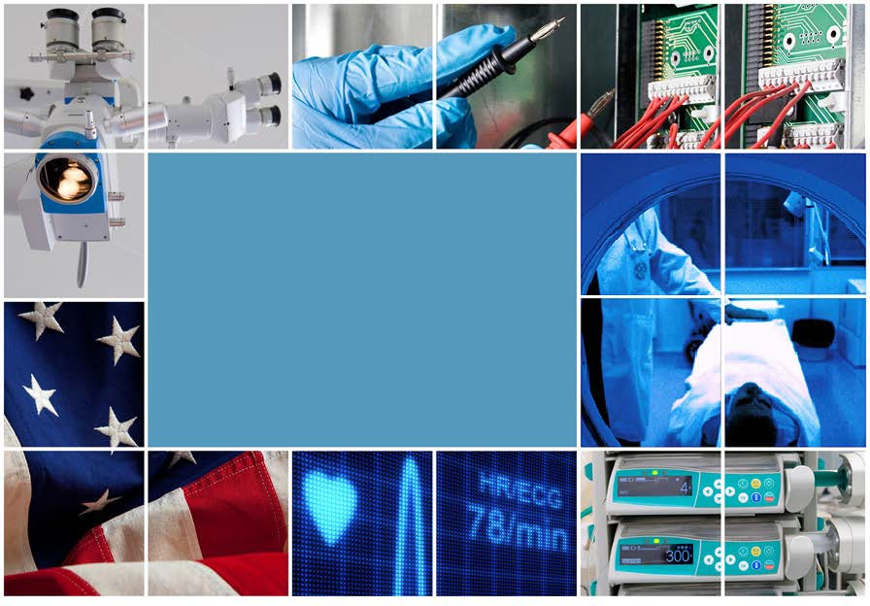

HTM Cybersecurity
HTM 214

Slide 2
Course Outline
What is Cybersecurity?
What is Privacy?
Unique Implications for Medical Devices
Core Components of a Cybersecurity Program
Top Healthcare Cyber Security Threats
Identifying Vulnerabilities
Risk Assessments
Risk = Threat + Consequence + Vulnerability
Common Tools in Cybersecurity
Reviewing a Cybersecurity Report

Slide 3
Module 1 Objectives
Discuss the unique cybersecurity implications for medical devices
Understand the scope of current cybersecurity threats
Identify the organizations establishing program requirements (NIST, FDA, CISA)
The NIST cybersecurity framework overview

Slide 4
What is Cybersecurity?
Cybersecurity is a set of processes, best practices, and technology solutions that help protect your critical systems and network from digital attacks. – Microsoft
Prevention of damage to, protection of, and restoration of computers, electronic communications systems, electronic communications services, wire communication, and electronic communication, including information contained therein, to ensure its availability, integrity, authentication, confidentiality, and nonrepudiation. – National Institute of Standards and Technology (NIST)

Slide 5

Why is cybersecurity an issue?
Originally all networks used open and unsecure protocols
All data was stored and transmitted in a clear-text format
Very few safety features
Many safety features

Slide 6
Why is cybersecurity an issue?
Data protection was implemented by restricting access to the network

Slide 7
Why is cybersecurity an issue?
Removing access restrictions means every data asset must be protected individually!

Slide 8
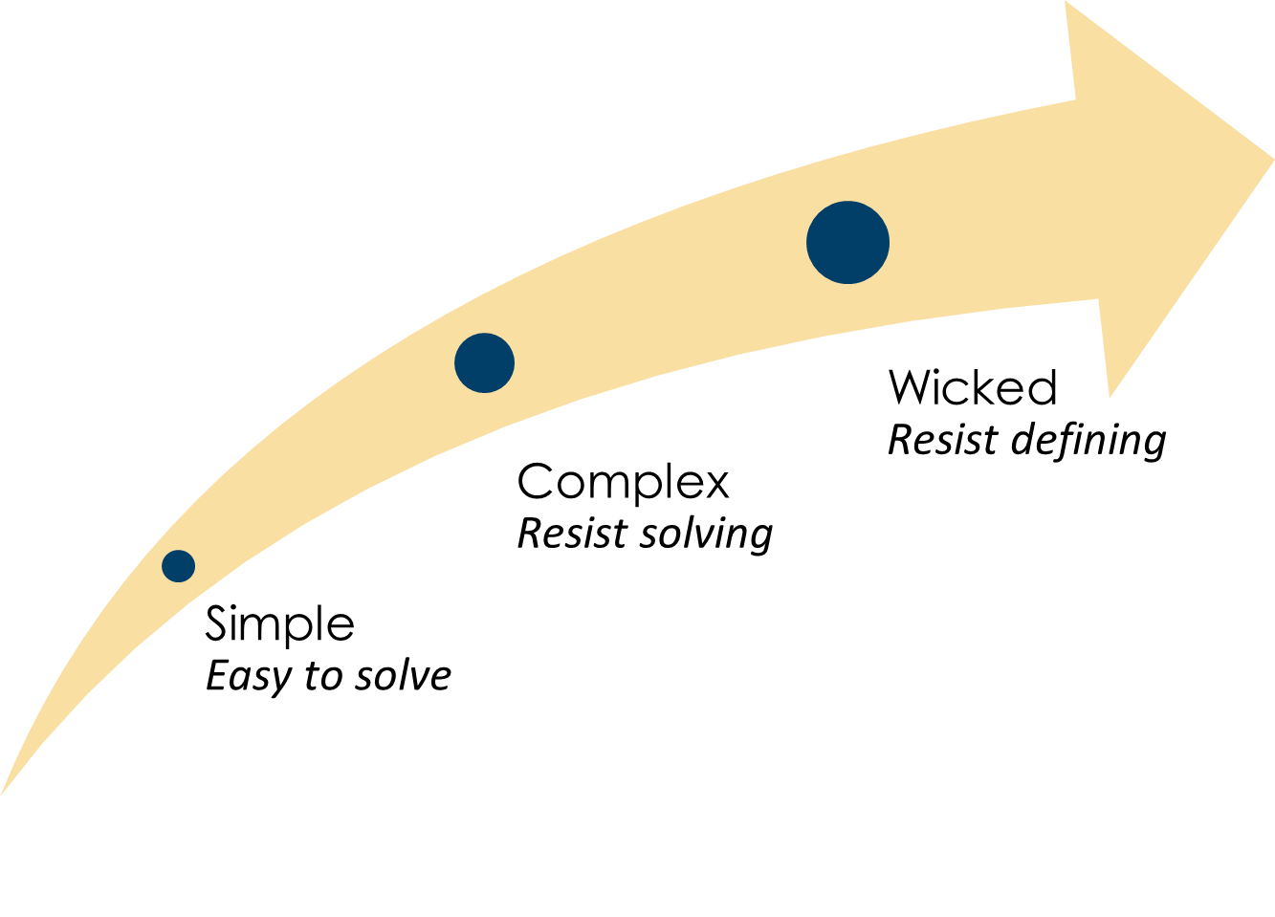
Why is cybersecurity an issue?
This creates a “wicked” problem.
Wicked problems are:
Ambiguous and chaotic,
Not well understood,
Continuously shifting,
Have no set precedents,
Have many possible solutions,
Often non-quantifiable

Slide 9
Where must data be protected?
Data at rest – Any file storage area such as hard drives, databases, USB drives, CD/DVD, cloud
Data in transit – Any data being transmitted between networked systems
Data in use – Any data in use by applications, in memory, or by the CPU

Slide 10
The CIA Triad
Confidentiality
Integrity
Availability

Slide 11
The CIA Triad: Confidentiality
Confidentiality – “keep it secret, keep it safe” – Gandalf
Protecting Confidentiality:
Authentication
Encryption
Data loss prevention

Slide 12
The CIA Triad: Integrity
Integrity – ensures data has not been tampered with or modified by unauthorized parties, ensuring its accuracy, completeness, and consistency
Protecting Integrity:
Hashing
Digital signatures
Testing

Slide 13
The CIA Triad: Availability
Availability - the assurance that data and systems are available and accessible to authorized users whenever needed
Protecting Availability:
Access controls
High availability
Monitoring and alerting

Slide 14
Criticality Impact of the CIA Triad
C-I-A = Business Critical
A-I-C = Mission Critical
I-A-C = Life Critical
Integrity
Availability
Confidentiality
Integrity
Availability
Confidentiality
Confidentiality
Availability
Integrity
Admin & Financial Systems (e.g., email, billing )
General Clinical Systems (e.g., ADT, RIS)
Specialty Clinical Systems (e.g., Lab, Pharmacy)
Medical Devices
(e.g., Pumps, Ventilators)
Increasing Risk of Patient Harm
Notes:
Of course, this is generalized, exceptions and variations exist.
The key point is to understand how C_I-A priorities can vary based on the type of systems and type of harm that can result from a security event.
It is not one or the other, but which ones are most critical under given circumstances. And sometimes more than one consideration is important, we may have to prioritize Availability and Integrity.
This would also be a good time to introduce the concept of direct harm (e.g., incorrect dosage as an integrity compromise) vs. indirect harm (delay in care as a availability compromise)

Slide 15
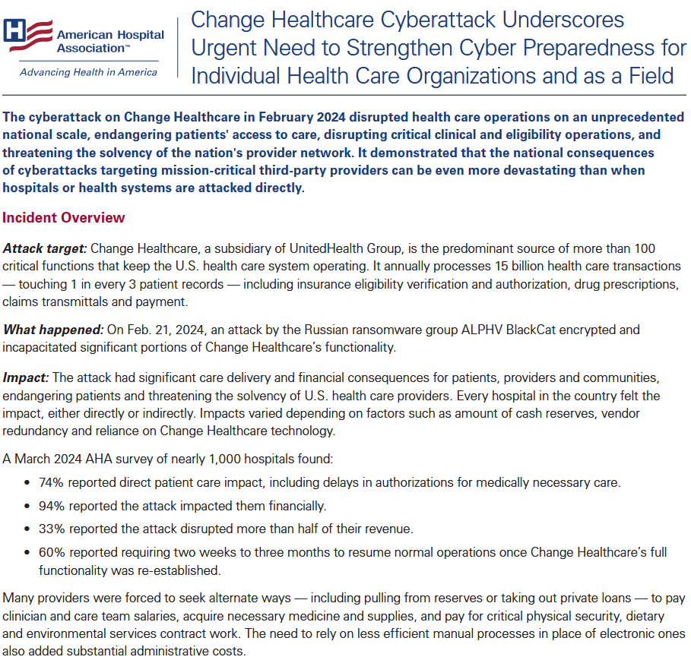
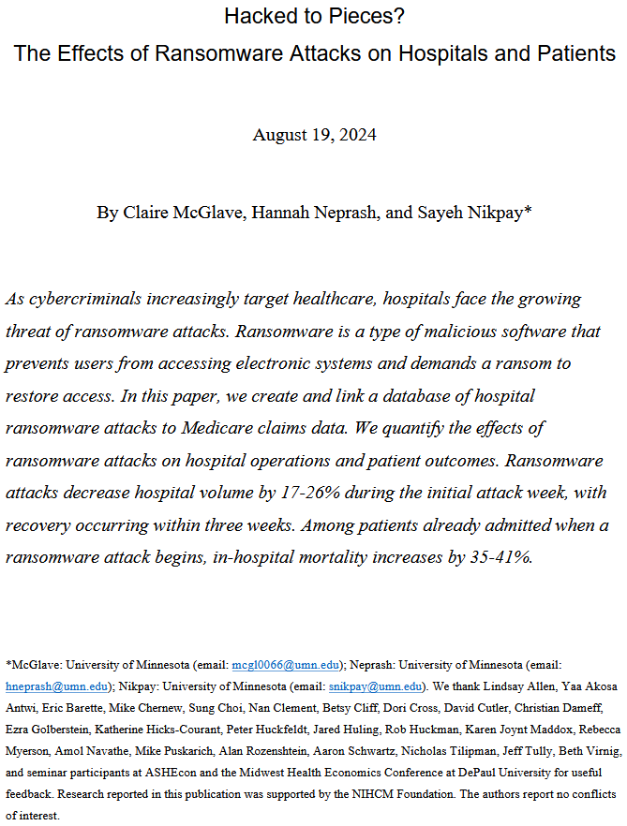
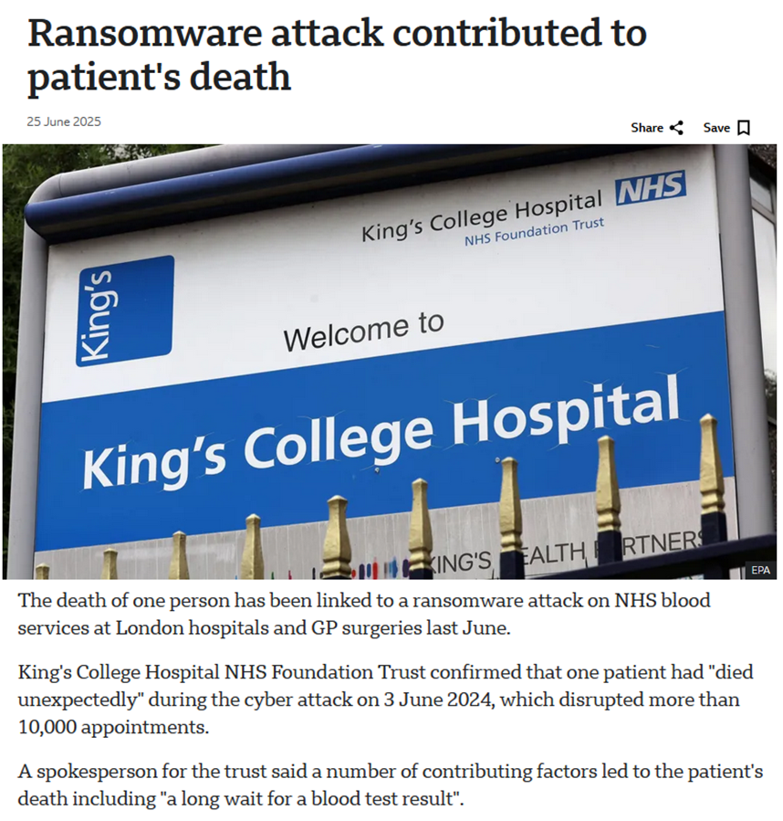
Examples: Criticality Impact of the CIA Triad
Change Healthcare Ransomware Attack
U of MN Mortality
Rate Study
Synnovis Ransomware Attack (NHS London, UK)
https://www.aha.org/system/files/media/file/2025/02/Change-Healthcare-Cyberattack-Underscores-Urgent-Need-to-Strengthen-Cyber-Preparedness.pdf
https://papers.ssrn.com/sol3/papers.cfm?abstract_id=4579292
https://www.bbc.com/news/articles/cp3ly4v2kp2o
Notes:
The results of a security event can be quite different, as these examples show.
Change Healthcare Impact:
• 74% reported direct patient care impact, including delays in authorizations for medically necessary care.
• 94% reported the attack impacted them financially.
• 33% reported the attack disrupted more than half of their revenue.
• 60% reported requiring two weeks to three months to resume normal operations once Change Healthcare’s full functionality was re-established
U of MN Study
Ransomware attacks decrease hospital volume by 17-26% during the initial attack week, with recovery occurring within three weeks.
Among patients already admitted when a ransomware attack begins, in-hospital mortality increases by 35-41%.
Synnovis (NHS London):
Disrupted more than 10,000 appointments
Several cases of patient harm, including oen death, attributed to delay in test results

Slide 16
Implement Security Controls
Detective
  Identify and detect security incidents and anomalies in real-time or near real-time
Preventative
  Proactive measures designed to prevent security incidents and cyber attacks from occurring in the first place
Corrective
  Respond to and recover from security incidents
Compensating

Slide 17
Detective Controls
Intrusion Detection Systems (IDS)
  Monitors network traffic and identifies suspicious patterns or behavior that may indicate unauthorized access or malicious activities.
Security Information and Event Management (SIEM)
  Aggregate and analyze log data from various sources to detect and alert on potential security incidents.
Security Auditing and Logging
  Monitoring and recording events, activities, and access attempts help track user actions and detect unauthorized activities.
Anomaly Detection
    Using machine learning and behavioral analysis to identify abnormal patterns that may indicate cyber threats.

Slide 18
Preventative Controls
Firewalls
  Filter network traffic and block unauthorized access, helping to protect against external threats.
Antivirus and Antimalware Software
  Scan files and systems for known malware and prevent malicious software from executing.
Access Controls
  Implementing strong authentication mechanisms and enforcing the principle of least privilege to limit access to sensitive information.
Patch Management
    Keeping software, operating systems, and applications up-to-date with the latest security patches to address known vulnerabilities.

Slide 19
Corrective Controls
Incident Response Plan
  Having a well-defined incident response plan in place to guide the organization's response to security incidents.
Data Backups and Recovery
  Regularly backing up critical data and having a robust data recovery strategy to restore systems in case of data loss or ransomware attacks.
Forensics and Investigation
  Conducting post-incident investigations to determine the root cause of the breach and gather evidence for legal and remediation purposes.
Penetration Testing and Red Teaming
    Simulating cyber attacks to identify weaknesses and test the effectiveness of security measures

Slide 20
Implement Security Controls (Categories)
Physical
  Focus on protecting the physical assets of an organization, such as its buildings, equipment, and sensitive data stored in physical form.
Technical
  Cybersecurity measures implemented through technology and software to protect digital assets, networks, and systems.
Procedural
  Policies, guidelines, and best practices to ensure that employees and users follow secure and responsible behavior.

Slide 21
Physical Controls
Physical Access Control Systems
  Badges, access cards, or biometric authentication to restrict access to physical facilities and sensitive areas within the organization.
Surveillance Cameras
  Monitor critical areas, deter potential threats, and provide video evidence in case of incidents.
Perimeter Security
  Fencing, gates, locks, and security personnel help control and secure the physical perimeter of the organization's premises.

Slide 22
Technical Controls
IDS/IPS and Firewalls
  Monitor and filter network traffic for signs of suspicious or malicious behavior and can block or alert on potential threats.
Endpoint Protection
  Endpoint security solutions such as host-based firewalls, IPS, virus and malware software.
Authentication, Authorization, and Accounting (AAA)
  A robust framework for controlling access to resources, ensuring that only authorized users can access sensitive data and systems.

Slide 23
Technical Controls
Encryption
  Symmetric Key Encryption
  Asymmetric Key Encryption
  Hashing
  Digital Signatures
  Public Key Infrastructure

Slide 24
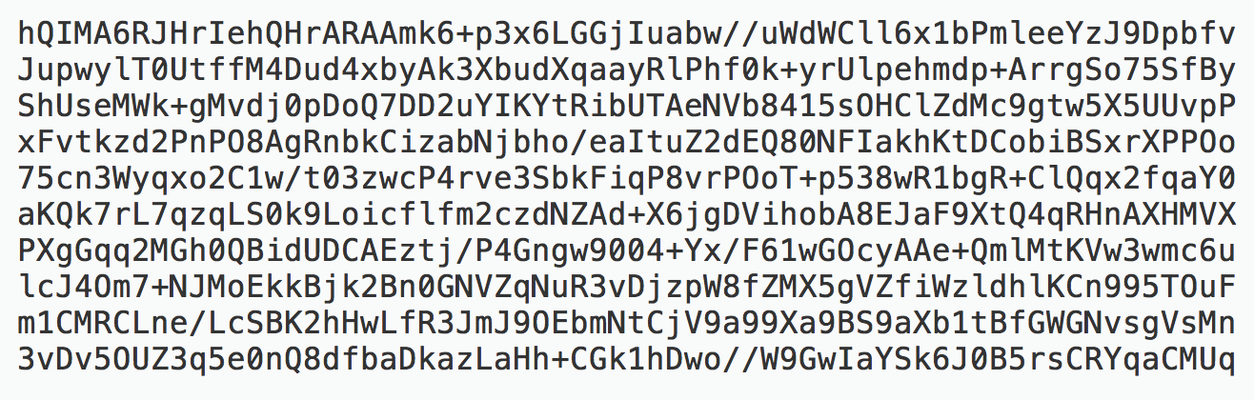
Encryption (Cryptography)
How does cryptography work?
Cypher (encryption algorithm)
Key (password)
Plaintext
Cyphertext

Slide 25
Technical Controls
Symmetric Key Encryption
  Same key to encrypt and decrypt
  Fast
  Encrypts Bulk Data
  Asymmetric Key Encryption
    Public key encrypts
    Private key decrypts
    Slow
    Encrypts small amounts of data (keys)

Slide 26

Technical Controls
Encryption Algorithms
  Must be well tested to be reliable
Encryption Keys
  Must be long and strong

Slide 27
Technical Controls
Hashing
  Provides integrity
  Integrity proves data has not been changed or altered
Digital Signatures
  Prove authenticity
  Provide non-repudiation

Slide 28
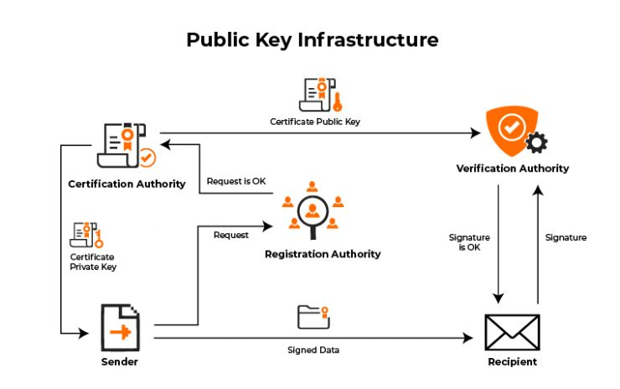
Technical Controls
Public Key Infrastructure
  A trusted third party verifies authenticity of each party to the transaction
  Assures strong encryption for the connection
Source: https://www.sbnewsroom.com/best-public-key-infrastructure-practices/

Slide 29
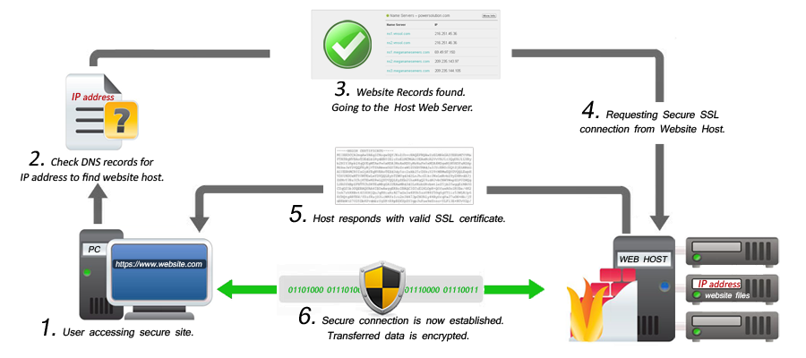
Technical Controls
SSL/TLS Encryption
  Verifies public keys
  Encrypts bulk data using symmetric key encryption
  Encrypts keys using asymmetric key encryption
  Provides integrity using hashing (HMAC)
  Uses a 256-bit key
Source: https://arkit.co.in/secure-web-server/

Slide 30
Technical Controls
Encryption for data at rest (stored data)
    Bitlocker (Windows)
    LUKS (Linux)
  Encrypting data in use (RAM and CPU)
    Trusted Platform Module
    Full Memory Encryption
    Homomorphic Encryption

Slide 31
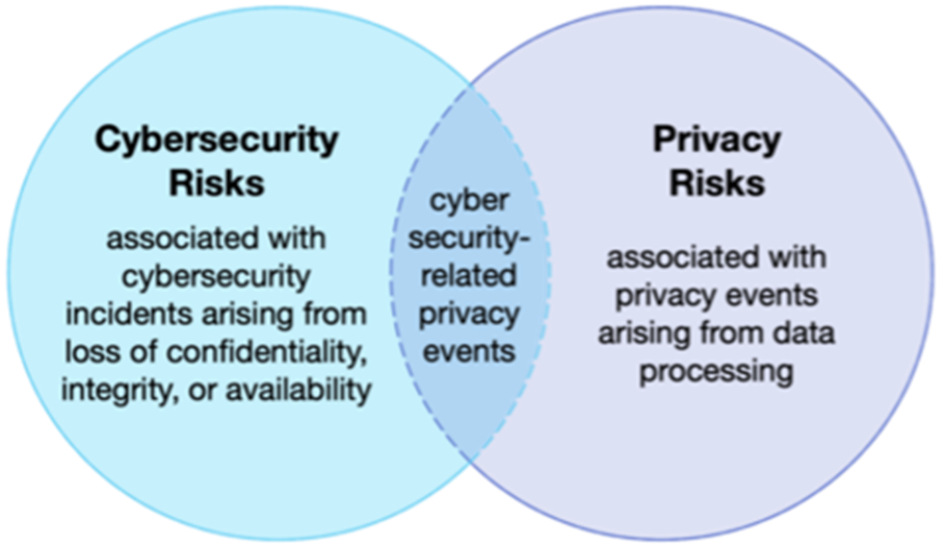
Security and Privacy
Cybersecurity events typically target private or financially sensitive information
Intent to do harm or damage is a common element of terrorism, or war

Slide 32
Privacy Laws: Implementing the CIA Triad
Privacy Laws
  Ensure that individuals' privacy rights are respected and that their personal data is handled responsibly and securely by organizations and entities that collect or process such data.
Consent
Purpose Limitation
Data Minimization
Data Security
Individual Rights
Data Breach Notification
Cross-Border Transfers
Sensitive Data

Slide 33
Privacy Laws: Implementing the CIA Triad
United States
  HIPAA
  FCRA
  FERPA
  GLBA
  ECPA
  COPPA
  VPPA
  FTCA
Canada
  PIPEDA
United Kingdom
  DPA 2018
European Union
  GDPR
Australia
  Privacy Act 1988 and updates
https://www.nytimes.com/wirecutter/blog/state-of-privacy-laws-in-us/

Slide 34
Privacy Laws: Implementing the CIA Triad
Personally Identifiable Information (PII)
  Information that can be used to uniquely identify an individual
  Can refer a single piece of information, or a combination of pieces
Name
Social Security Number
Date of Birth
Phone Number
Email Address
Driver’s License Number
Passport Number
Financial Information
Medical Information
IP Address
https://www.hhs.gov/hipaa/for-professionals/special-topics/de-identification/index.html

Slide 35
Privacy Laws: Implementing the CIA Triad
Protected Health Information (PHI)
  Sensitive and confidential information related to an individual's health and medical condition
Medical History
Diagnostic Data
Medical Records
Medication Records
Allergies and Sensitivities
Family Medical History
Health Insurance Details
Biometric Data
Mental Health Information
Unique Identifiers (patient record numbers)

Slide 36
Privacy Laws: Implementing the CIA Triad
Confidential Commercial Information (CCI)
  Proprietary business data that is used to maintain a competitive advantage and protect the interests of the business or organization
Trade Secrets
Financial Data
Marketing Strategies
Customer Lists
Research and Development Data
Contractual Information
Pricing Information
Intellectual Property
Strategic Plans
Business Process Information

Slide 37
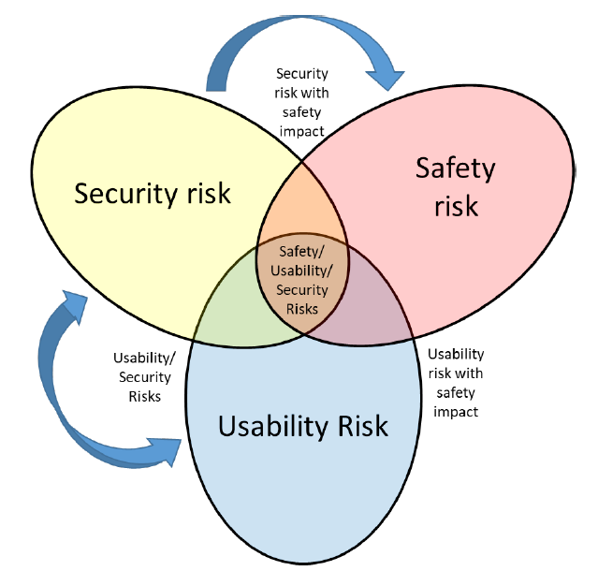
Additional Medical Device Risk Forms
Interrelationship between safety, usability, and security (source: AAMI SW 96)
Example: Data Breach and Privacy
  Hackers steal an Ultrasound scanner, and 8000 images are compromised with patient data
  Data stolen from unencrypted transmission methods
  Date stolen as a result of poor decommissioning
  Data stolen due to lack of data sanitation
Notes:
Security vs Privacy from handout
Examples Security vs Privacy vs Usability Conflicts:
Security – Privacy: Data breach (see also HIPAA Breach Notification Law)
Security – Usability: Shared PINs on shared devices, e.g., infusion pumps
Security – Safety: Strong password on life critical devices e.g., a defibrillator

Slide 38

Intermediate Cybersecurity Review

Slide 39

Who are the hackers (threat actors)?
Hackers
  Individuals or groups with advanced technical skills who attempt to penetrate networks or systems to exploit vulnerabilities, steal data, disrupt services, or cause damage for various reasons, such as financial gain, political motives, or personal satisfaction

Slide 40
Who are the hackers (threat actors)?
Script Kiddies
Malicious Insiders
Hacktivists
Cybercriminals
Organized Crime Groups
State Sponsored Groups
Nation States
Advanced Persistent Threat Groups (APT)

Slide 41
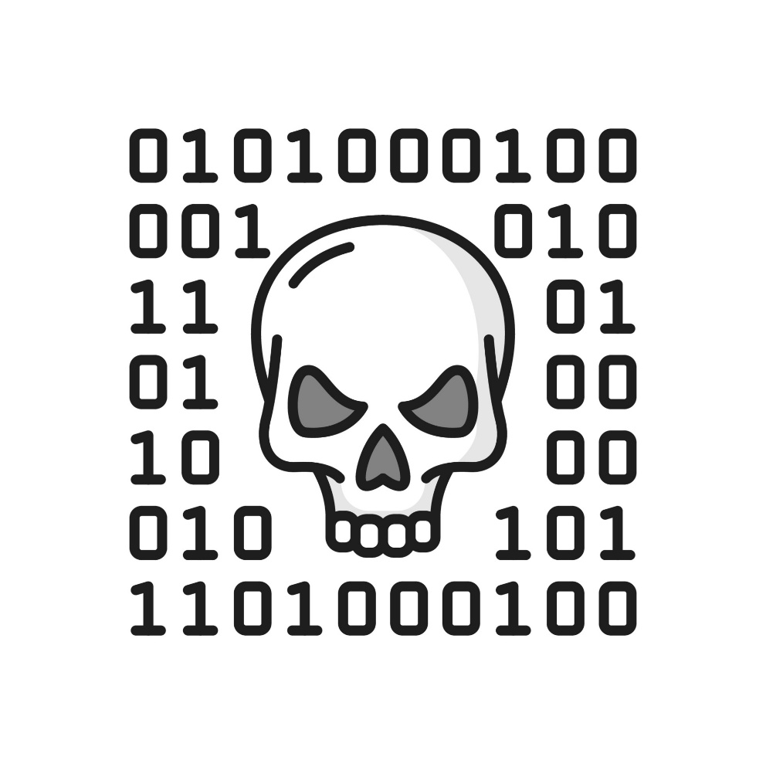
What are hackers looking for?
Vulnerabilities - A weakness or flaw in a system, network, application, or process
  Social Engineering
  Software
  Hardware
  Web Applications
  Authentication
  Supply Chain
  Zero-Day

Slide 42
Medical Device Security Issues
Technical:
Devices designed before modern threats
Device designed based on exposed commercial/open-source software
Aging technology not supporting modern network security
Many devices not scannable by common network scanners
Lack of security event detection (signals and logs)
Legacy devices (e.g., end-of-support operating system

Slide 43
Medical Device Security Issues
Process:
Security not considered during procurement
Split responsibilities and lack of stakeholder cooperation
Lack of inventory visibility across networks
Lack of security property information per device

Slide 44


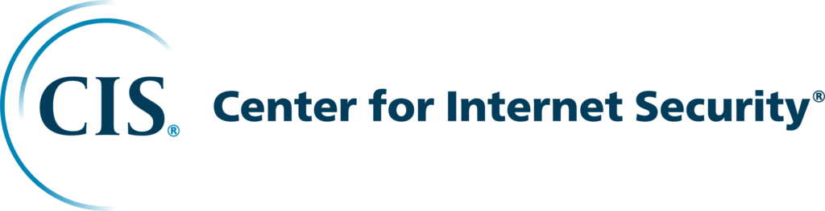
Purpose of Cybersecurity Frameworks
Serve as a blueprint for your cybersecurity posture
Provide a common language
Establish a consistent baseline
Risk-based prioritization
Regulatory and contractual compliance
Interoperability and trust

Slide 45
Frameworks: Implementing the CIA Triad
NIST Cybersecurity Framework
NIST Risk Management Framework
ISO 27001 Series
CIS (Center for Internet Security)

Slide 46
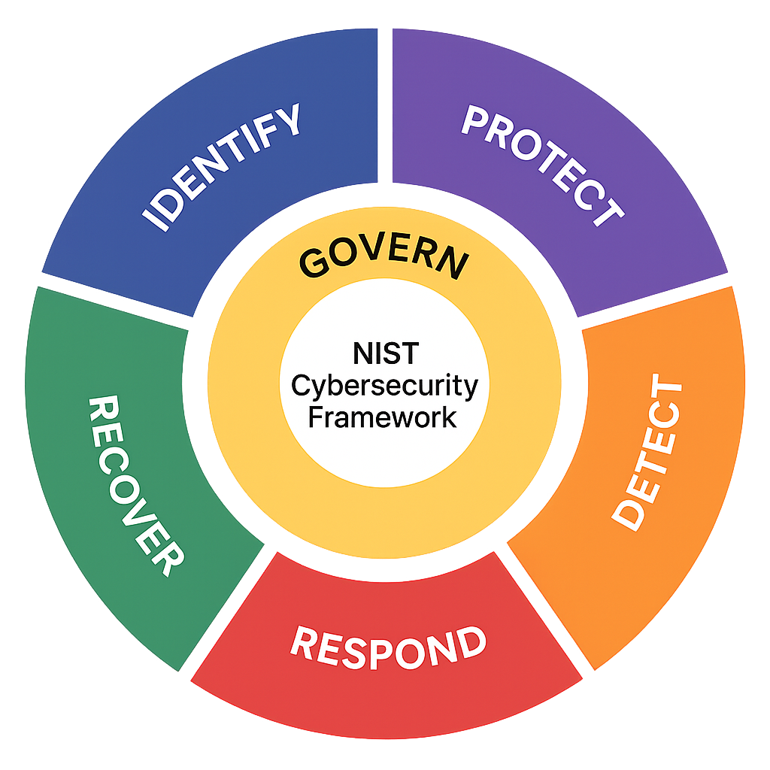
NIST Cybersecurity Framework
Govern: Aligning security with the organizations mission
Identify: Knowing the environment and its vulnerabilities
Protect: Reducing the attack surface and securing data
Detect: Identifying anomalies and malicious activity early
Respond: Taking decisive action to stop an incident
Recover: Returning to "business as usual" post-incident
Building a Cybersecurity Framework

Slide 47
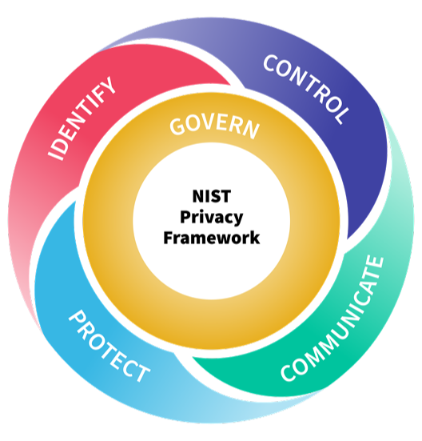
NIST Privacy Framework
Govern-P: Establish the governance, policies, and leadership oversight to prioritize privacy
Identify-P: Map the data ecosystem to understand what personal info is processed and why
Control-P: Implement technical tools that enable granular data management and minimization
Communicate-P: Ensure transparency through clear notices and dialogues regarding data usage
Protect-P: Apply targeted security safeguards to prevent unauthorized data access or loss.

Slide 48
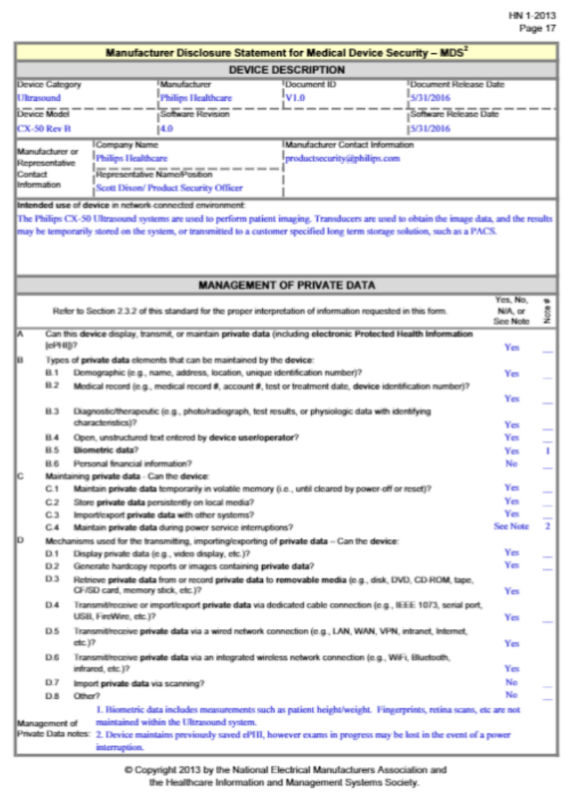
NIST and Medical Devices (MDS2)
MDS2: A standardized document that discloses a medical device's security capabilities to help healthcare providers manage risk and compliance.
Management of PII
Audit controls
Authentication
Data transmission
Patching and updates
Malware protection

Slide 49
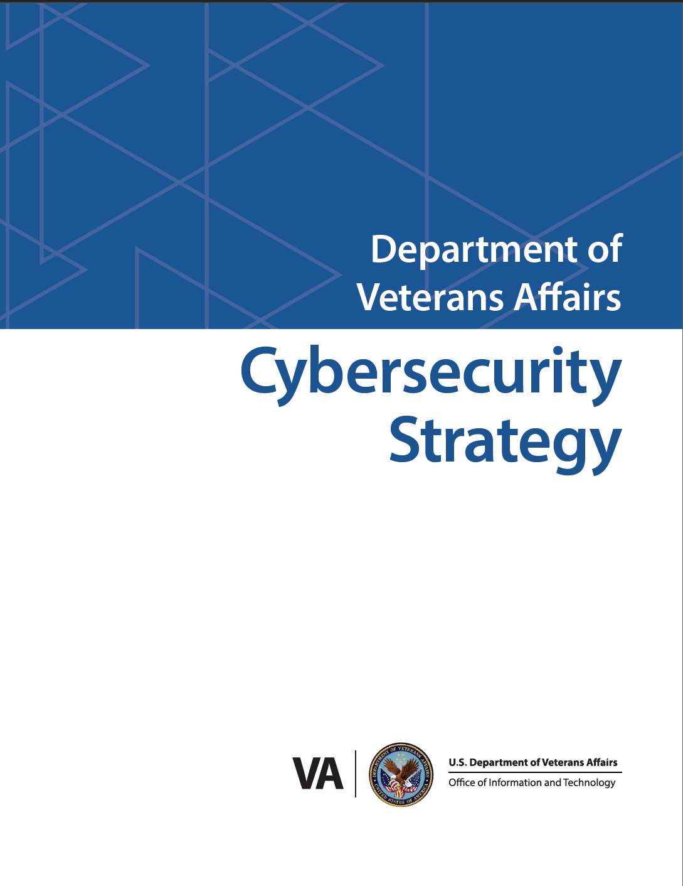
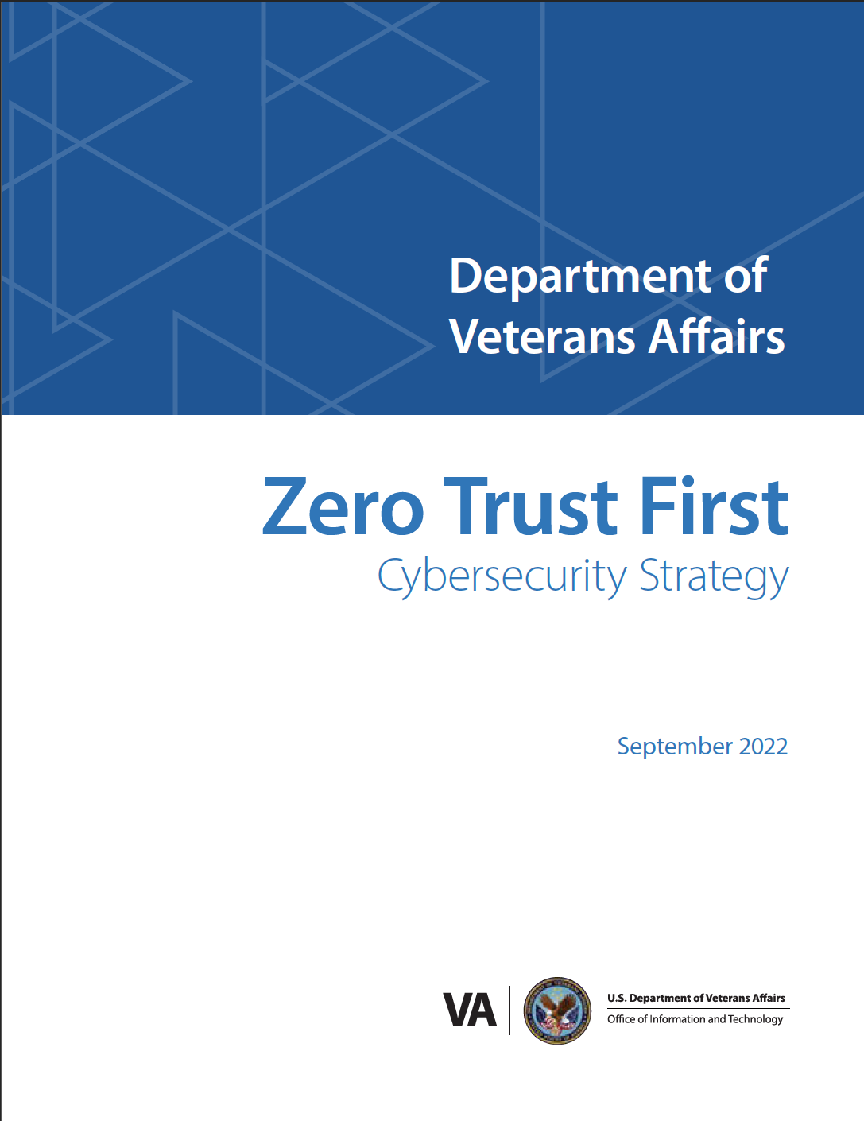
VA Cybersecurity Strategy

Slide 50
Module 2 Objectives
Identify the most common vulnerabilities within healthcare systems
Discuss the role of CISA and NIST in identifying vulnerabilities and remediations
Practice navigating the National Vulnerability Database and Known Exploited Vulnerabilities
Understand the role of AI in Cybersecurity

Slide 51
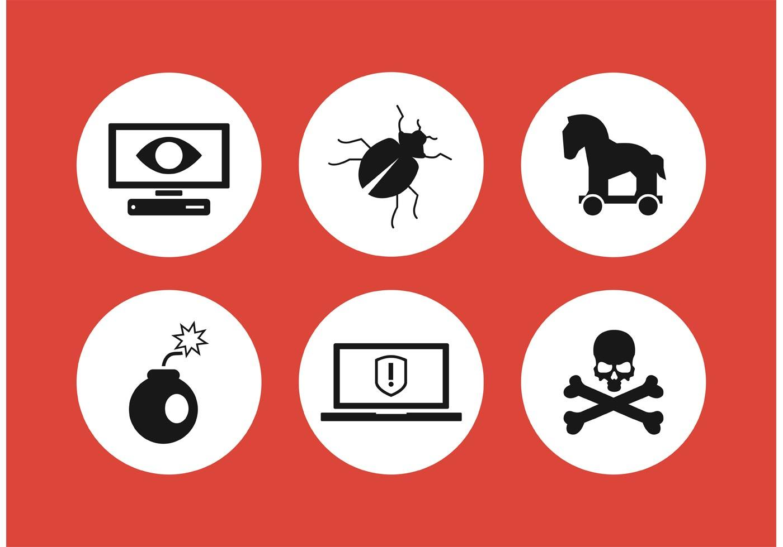
What are the major types of attacks (exploits)?
Malware
  Viruses
  Worms
  Trojans
  Ransomware
  Spyware
  Adware

Slide 52
What are the major types of attacks (exploits)?
Brute Force Attack
  Weak / default / easy-to-guess credentials are especially vulnerable
  Usernames / passwords may be well known or even published in training manuals or instructions for use (IFU)

Slide 53
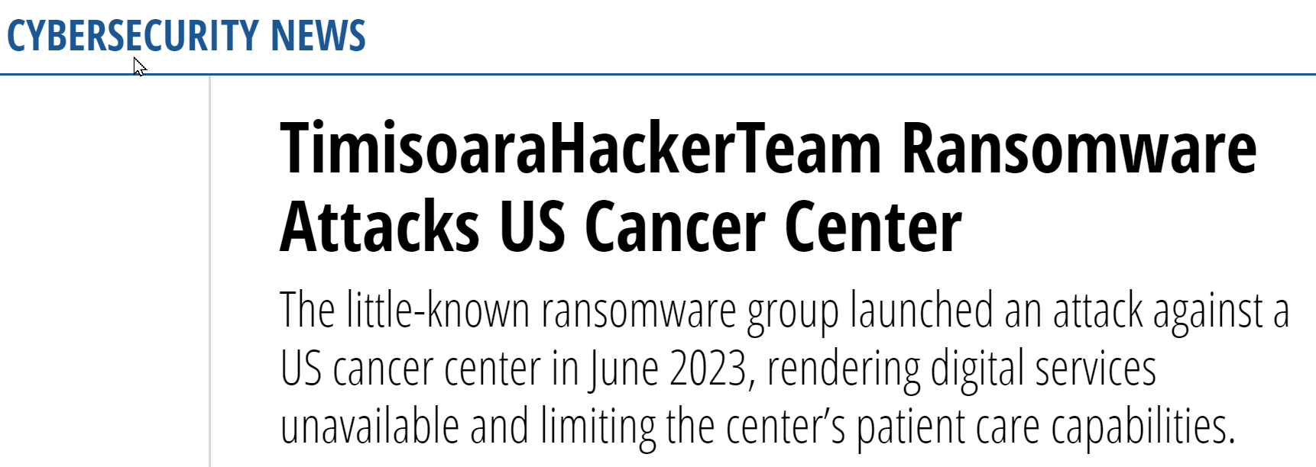
What are the major types of attacks (exploits)?
Ransomware
  Encrypts a victim's data, making it inaccessible, and demands a ransom for the decryption key.
Source: https://healthitsecurity.com/news/timisoarahackerteam-ransomware-attacks-us-cancer-center

Slide 54

What are the major types of attacks (exploits)?
Social Engineering
  Phishing/Spear Phishing
  Whaling
  Pretexting
  Tailgating/Piggybacking
  Watering Hole
  Impersonation/ Weak Authentication
  Vishing/Smishing

Slide 55
What are the major types of attacks (exploits)?
Only 3% of malware exploits an exclusively technical flaw. The other 97% targets users through social engineering (KnowBe4)
Source: https://www.sysgroup.com/insights/statistics-you-need-to-know-about-social-engineering/

Slide 56
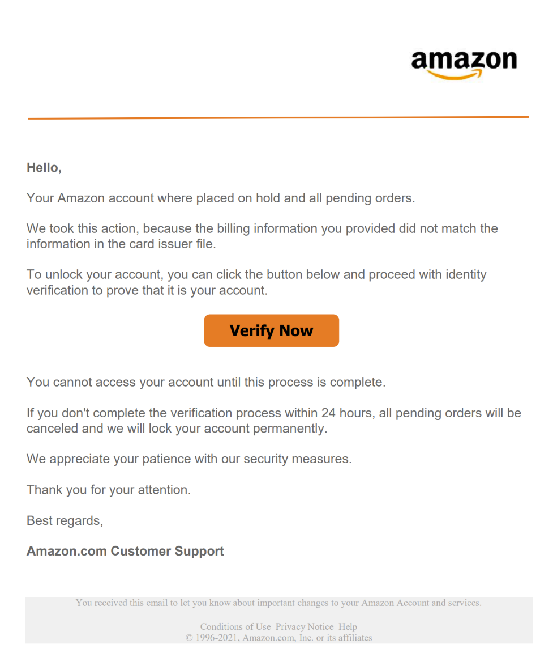
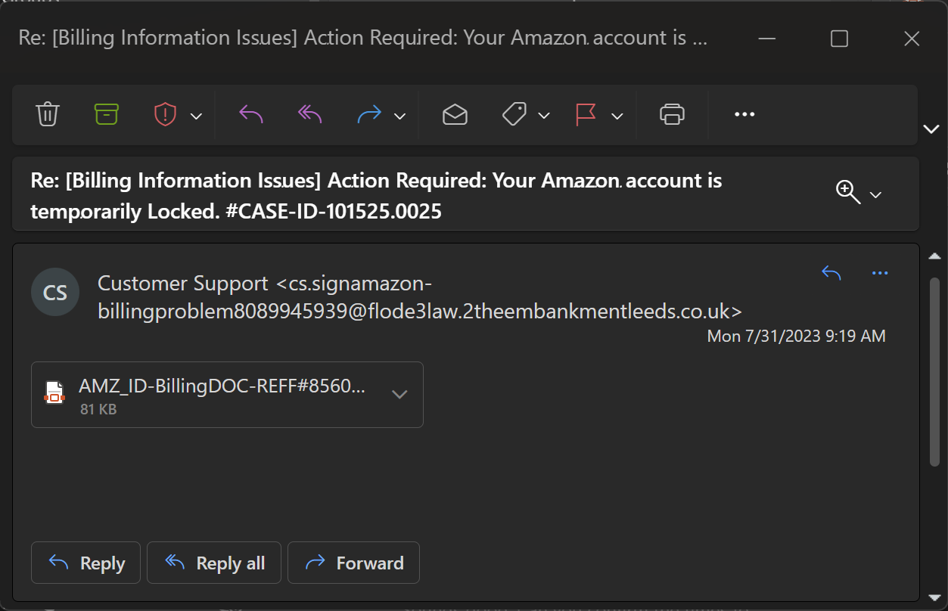
What are the major types of attacks (exploits)?
91% of cyber-attacks start through email (Mimecast)
https://www.linkedin.com/slink?code=gpuRus2a?id=85981398432

Slide 57
What are the major types of attacks (exploits)?
How many phishing emails do you get every day?

Slide 58
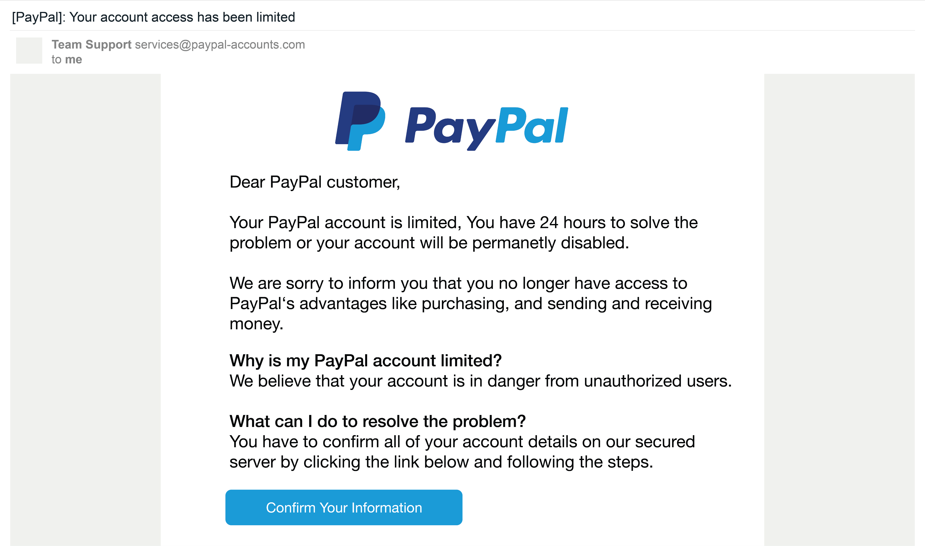
Lab 1 – Phishing Email Forensics

Slide 59
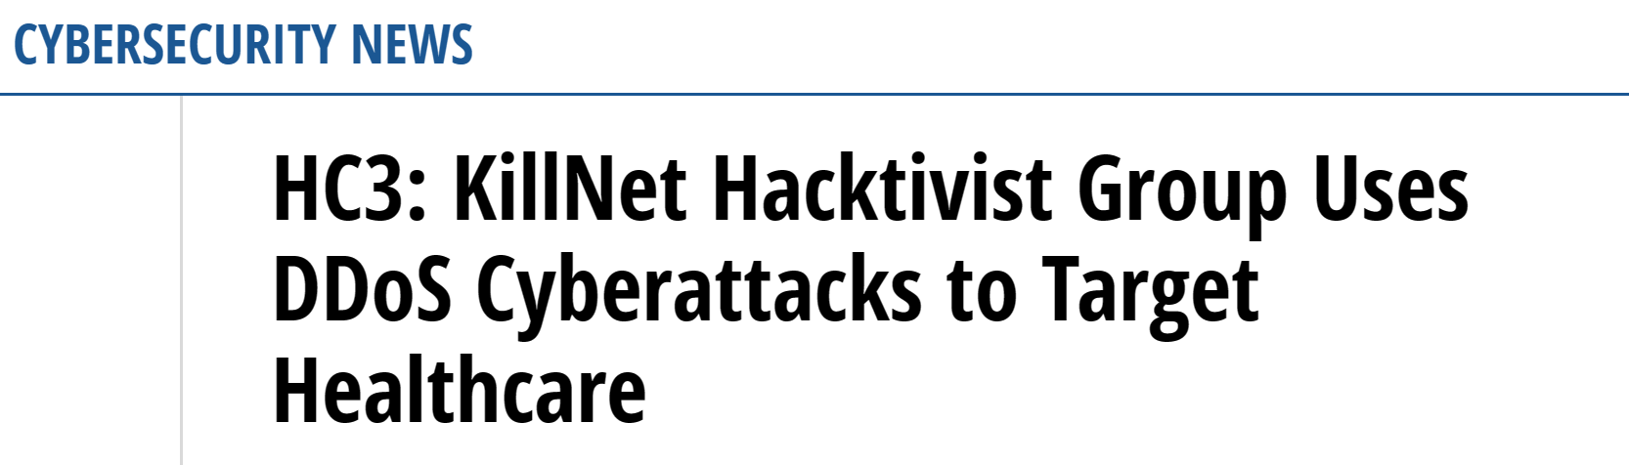
What are the major types of attacks (exploits)?
Distributed Denial of Service Attacks
  Overwhelm a target system with a massive volume of traffic, causing it to become inaccessible to legitimate users.
Source: https://healthitsecurity.com/news/hc3-killnet-hacktivist-group-uses-ddos-cyberattacks-to-target-healthcare

Slide 60
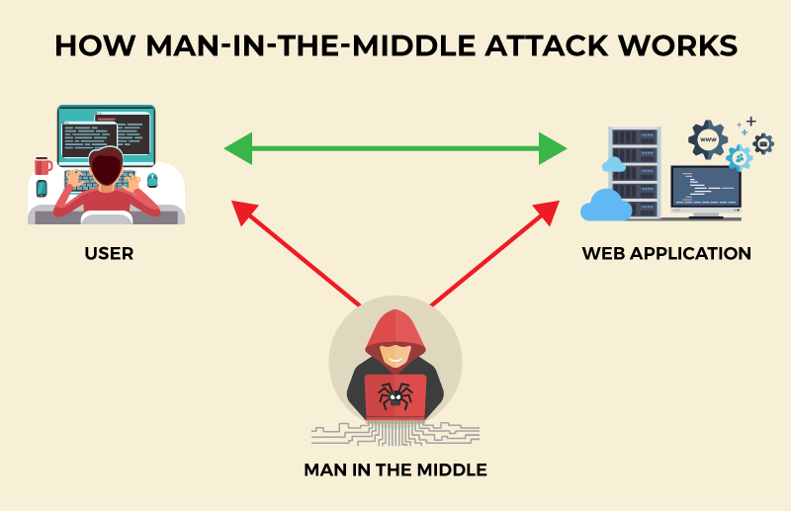
What are the major types of attacks (exploits)?
Man in the Middle Attacks
  An attacker intercepts and potentially modifies communication between two parties to eavesdrop on sensitive data.
Source: CISO Mag

Slide 61
What are the major types of attacks (exploits)?
Insider Threats
  Individuals with legitimate access to systems misusing their privileges for malicious purposes, such as stealing data or causing damage.

Slide 62
What are the major types of attacks (exploits)?
Insufficient Transport Layer Protection
  Device designed with weak or missing encryption
  Confidentiality risks (encryption); integrity risks (hashing and/or signing of data)
  Secure version of protocols turned off (e.g., DICOM (imaging), HL7 (ADT), or ASTM (Labs))

Slide 63
What are the major types of attacks (exploits)?
Web Application Attacks
  Cross Site Scripting - Injects malicious scripts into web pages
  SQL Injection - Injects malicious SQL code, allowing attackers to gain unauthorized access to databases and steal data.

Slide 64
What are the major types of attacks (exploits)?
Supply Chain Attacks
  Targets vulnerabilities in the systems, software, or hardware of a third-party vendor or supplier, with the ultimate goal of compromising the security of the final target organization or its customers.

Slide 65
What are the major types of attacks (exploits)?
Zero-Day Attacks
  Target vulnerabilities that are not yet known or patched by vendors, giving attackers the advantage of attacking before a fix is available.

Slide 66
What are the major types of attacks (exploits)?
Operating System Vulnerabilities
Slow patch release
Slow patch deployment
Unpatchable (legacy)
Broad exposure
Highly targeted (many exploits, malware production)
Conflict resulting from the use of a common (commercial or open source) software component in a regulated and highly sensitive and regulated device.

Slide 67
Identifying Vulnerabilities
Common Vulnerabilities and Exposures Database
Microsoft Security Blog
Cisco Security Blog and RSS Feeds
SecureWorks Blog
FBI
Krebsonsecurity.com
DarkReading.com
SANS Internet Storm Center
DoD Cyber Crime Center
Cybersecurity & Infrastructure Security Agency
CISA KEV
ICS-CERT

Slide 68
Identifying Medical Device Vulnerabilities
Medical Device Vulnerabilities can be reported in multiple ways
  CVE.org = listing all reported vulnerabilities (devices and SW components)
  National Vulnerability Database (NVD) = enriched CVEs (but falling behind since early 2024)
  ICS-CERT = device vulnerabilities; may point to NVD
  FDA = risk of harm or risk to care delivery; points to ICS-CERT and/or NVD
  Other agencies as needed = FBI, CISA and CISA KEV, NSA, HHS, …..
  Information Sharing Organizations = H-ISAC, MedISAO, HSCC, …
  Commercial and Complementary = VulnDB, VulnCheck, EPSS, GitHub
  Vendors: Software (MSFT, Adobe, etc.); medical device vendors via service portal or trusted channel
  International = EUVD, JVN (Japan), CNNVD and CNVD (China), Cert-In (India), ….

Slide 69
Identifying Medical Device Vulnerabilities
Be prepared for inconsistencies between reporting:
  Level of detail and structure may vary; e.g., NVD (structured) vs ICS-CERT (semi-structured) vs FDA (unstructured)
  Inconsistency due to objective, human judgement, and point in time
  Translation of general risk (e.g., SW vulnerability in NVD) to medical device risk may be difficult

Slide 70
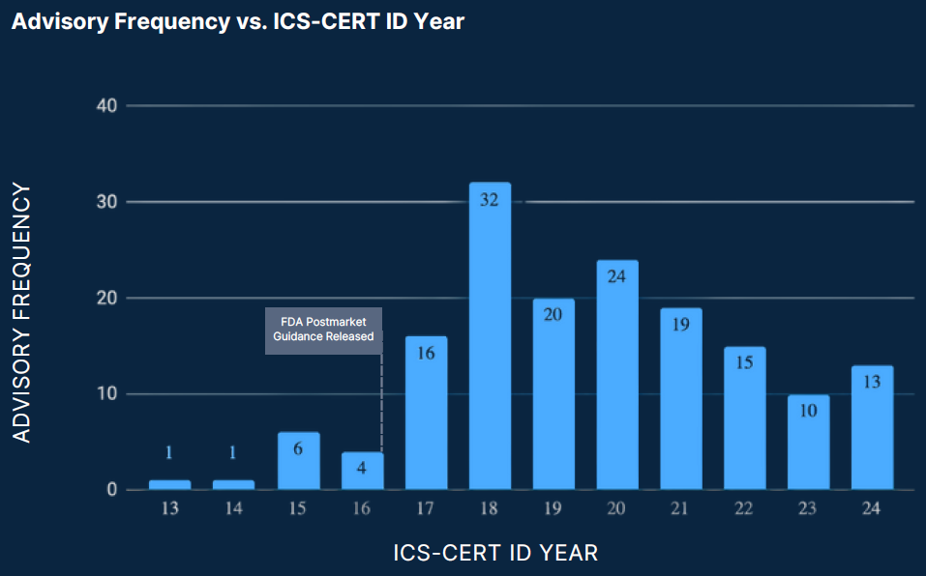
Example: ICS-CERT Annual Reporting
Medical Device Annual Vulnerability Reporting per Calendar Year
Source: https://www.medcrypt.com/cybersecurity-whitepapers/whitepapers-ics-cert-2024-medical-device-cybersecurity-trends
Notes:
For example, this slides shows the Medical Device specific vulnerabilities that have been reported to ICS CERT. Note the impact of the FDA Postmarket Cybersecurity Guidance that strongly encouraged device manufacturers to participate in active information sharing

Slide 71
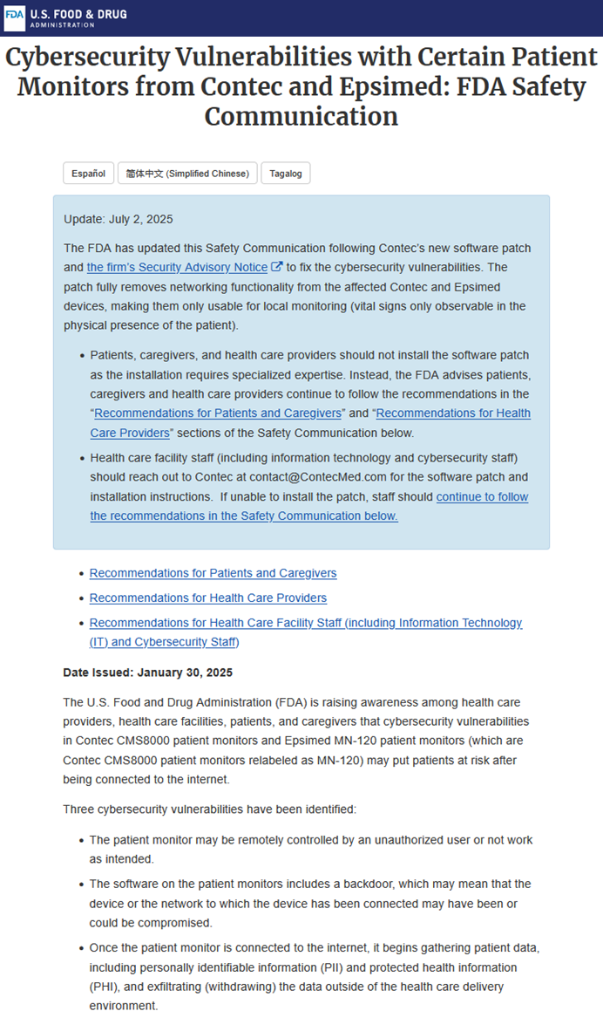
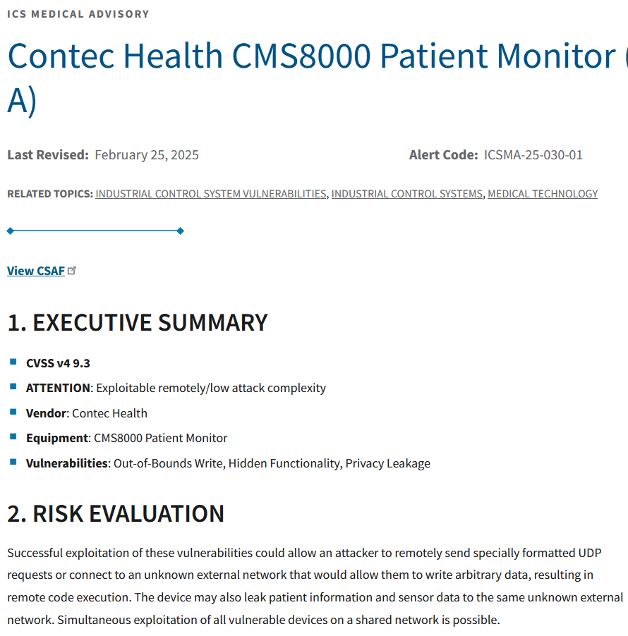
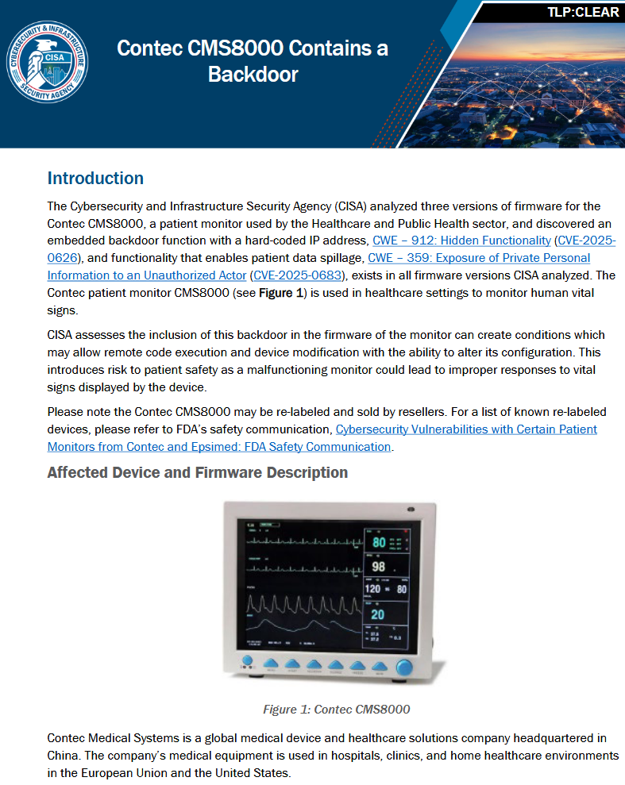
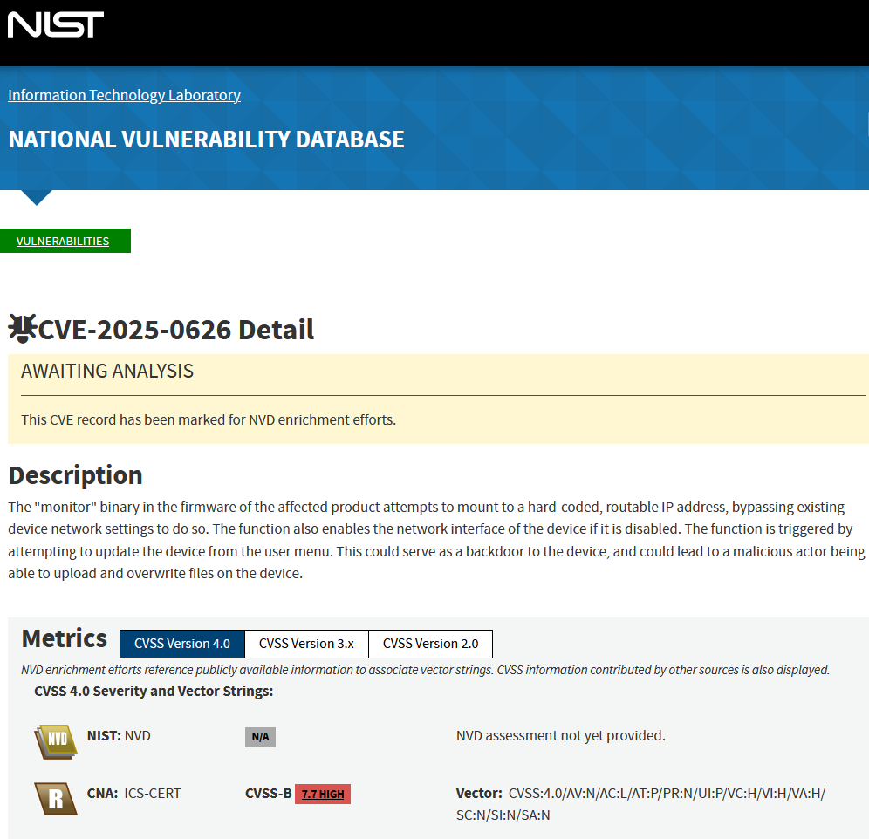
Example: Contec CMS8000 Monitor
https://www.cisa.gov/news-events/ics-medical-advisories/icsma-25-030-01
https://www.cisa.gov/sites/default/files/2025-01/fact-sheet-contec-cms8000-contains-a-backdoor-508c.pdf
https://www.fda.gov/medical-devices/safety-communications/cybersecurity-vulnerabilities-certain-patient-monitors-contec-and-epsimed-fda-safety-communication
https://nvd.nist.gov/vuln/detail/CVE-2025-0626
Notes:
Example of a medical device vulnerability Should note:
CMS8000 Backdoor was initially listed as a “hidden backdoor” which is not believed to be trye anymore – it was rather a really poor engineering decision. And it was certainly not “hidden” (listed in the manual)
NVD lists both device specific vulnerabilities (as in this example) and SW component vulnerabilities that may be associated with multiple devices and software products (e.g., Log4Shell)
Note NVD enrichment gap persisting since early 2024

Slide 72
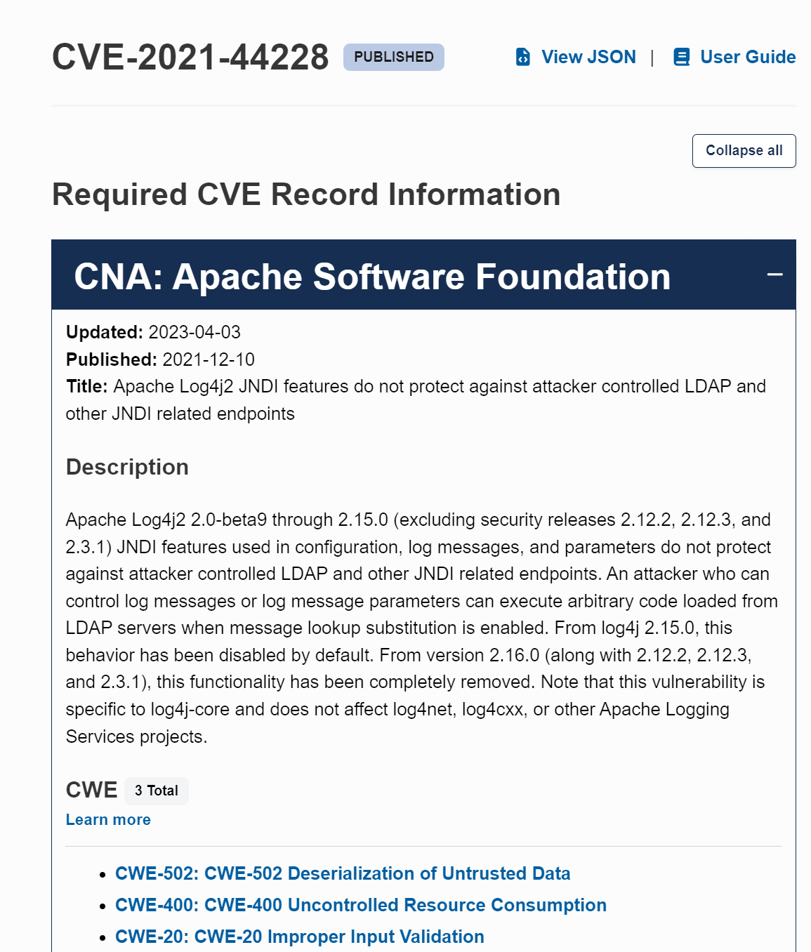
Lab 2 – CVE Hunting with NVD

Slide 73
Module 3 Objectives
Discuss the core components of a cybersecurity program
Conduct a risk assessment
Identify administrative or technical mitigations to reduce risk
Explain the purpose of a security audit
Describe the role of a SIEM in cybersecurity monitoring

Slide 74
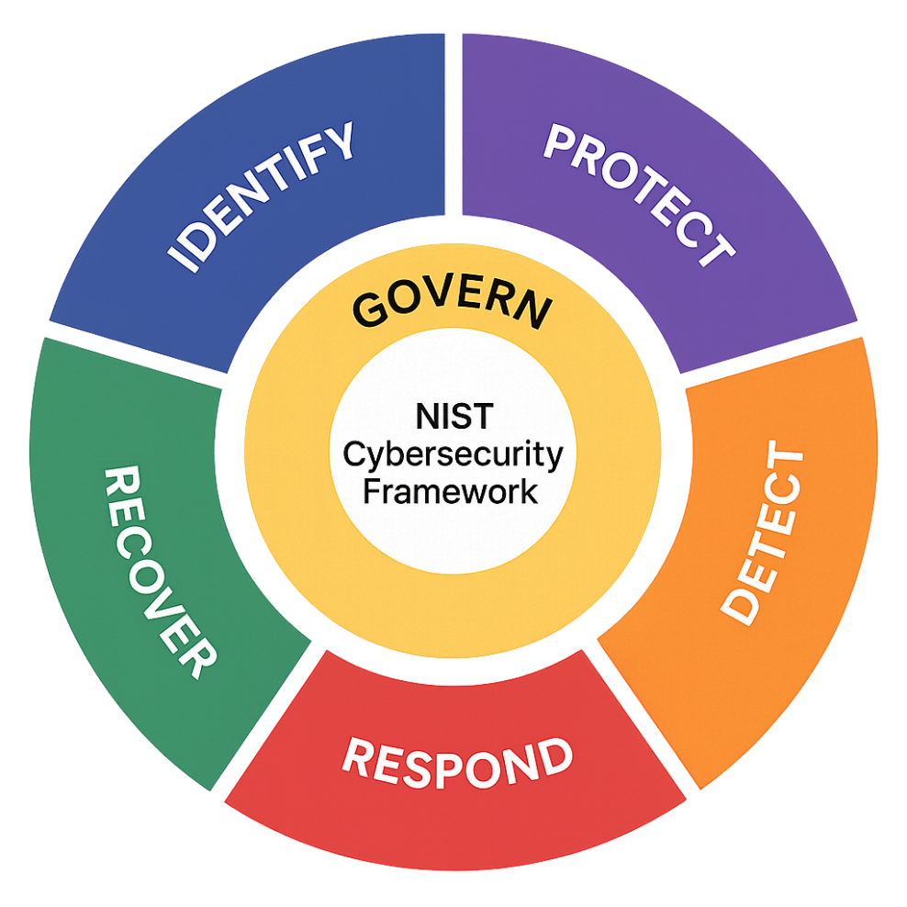
Cybersecurity Program Outline (1)
Assessment and Risk Analysis
Identify Assets and Prioritize
Set Objectives and Goals
Develop Policies and Procedures
Implement Security Controls
Employee Training and Awareness
Incident Response Plan
Continuous Monitoring and Evaluation

Slide 75
Cybersecurity Program Outline (2)
Compliance and Regulations
Testing and Drills
Cybersecurity Culture
Executive Support and Budgeting

Slide 76
Cybersecurity Program & Medical Devices
Process
Procurement
Compliance Audit
Deployment
Maintenance
Decommissioning
Vendor Selection / RFP
Incoming Inspection
Secure Integration
Patching
Data
Destruction
Activities
(examples)
Contracting
Document Review
Network Security
Incident Response
Recorded Evidence
Notes:
Example of components that should make up a medical device security program. Both process elements as well as activities and technical elements.

Slide 77
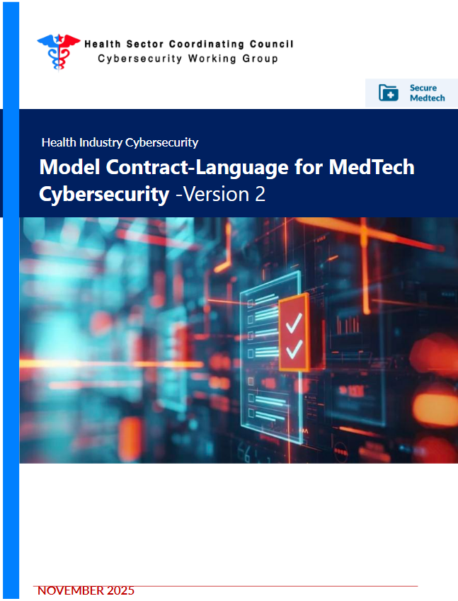
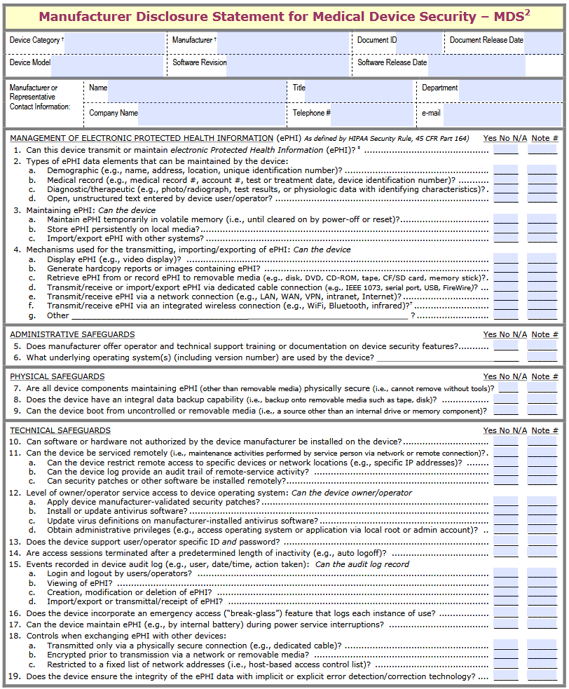
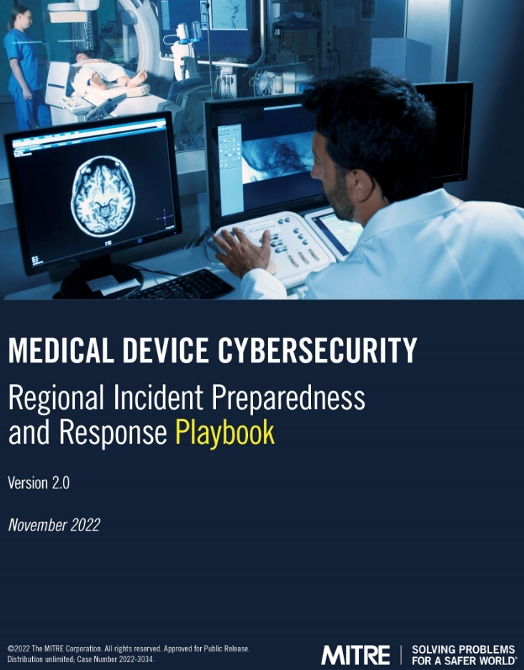
Cybersecurity Program Resources
https://healthsectorcouncil.org/wp-content/uploads/2025/11/MC2v2.pdf
https://www.makeitelectric.store/us/view-details/manufacturer-disclosure-statement-for-medical-device-security
https://www.mitre.org/sites/default/files/2022-11/pr-2022-3034-medical-device-cybersecurity-regional-preparedness-response-playbook.pdf

Slide 78
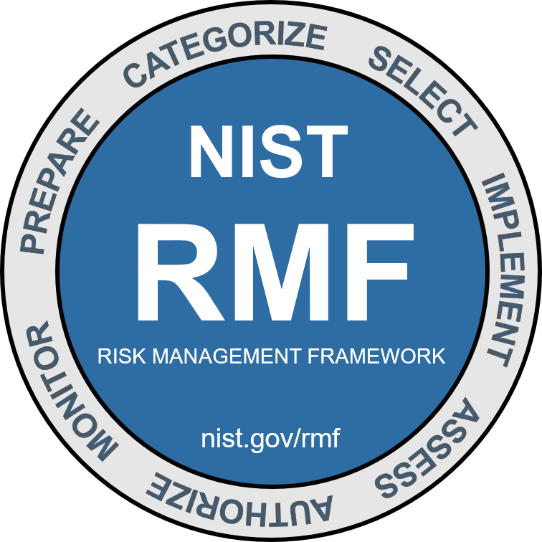
Assessment and Risk Analysis
Conduct a thorough assessment of the organization's existing IT infrastructure, identifying potential vulnerabilities, and assessing the level of risk to critical assets.
Source: https://csrc.nist.gov/Projects/risk-management/about-rmf

Slide 79
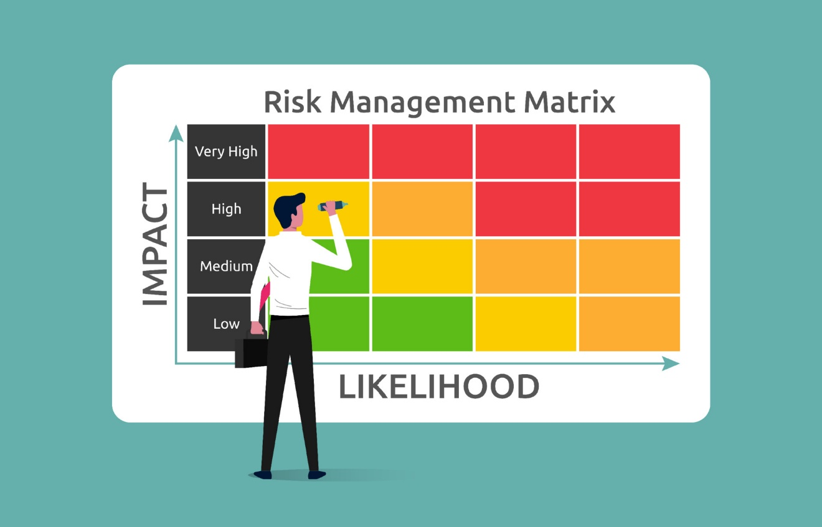
Assessment and Risk Analysis
Risk Management Options
  Mitigating Risk
    Cost effective controls
  Transferring Risk
    Insurance, SLA’s, MOU’s
  Avoiding Risk
    Change behavior causing risk
  Accepting Risk
    Some inherent risks are necessary

Slide 80
Medical Device Risk
Most generically, Risk is defined as the potential for a Threat to exploit a Vulnerability leading to the compromise of an Asset.
For Medical Devices, this means:
Device:
SW Vulnerability
Poor design (default password, …)
Operational:
Lack of timely patching
Insecure protocol (e.g., DICOM)
Vulnerability
exploits
Threat
Asset
compromises
Risk
Tangible:
Patient safety
Care delivery
Revenue. Lawsuits, Fines
Intangible:
Reputation
Treatment Decisions
Targeted threats, examples:
Intent to do harm
Medical device as entry point
Coincidental:
Medical device fits attack profile, e.g., commercial operating system
benefits

Slide 81
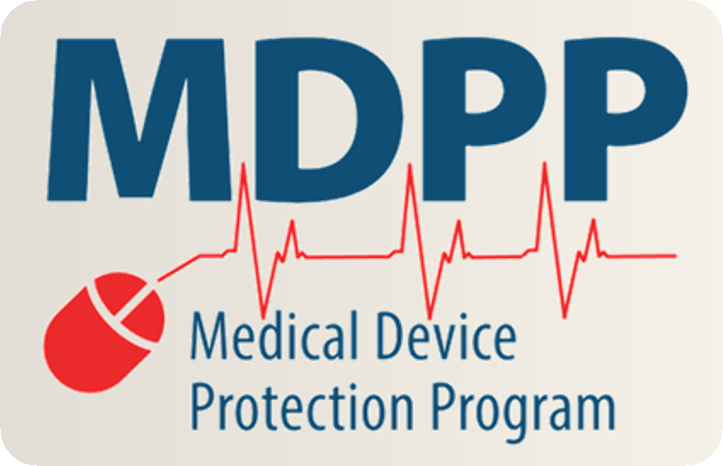
VA Cybersecurity Program
VA Directive 6500
  The cornerstone policy for the Department of Veterans Affairs (VA) Cybersecurity Program. It establishes the mandatory framework for protecting all VA information and information systems, ensuring they meet federal standards like FISMA.
VA Medical Device Protection Program
  A specialized cybersecurity initiative within the Department of Veterans Affairs designed to secure the "Internet of Medical Things" (IoMT).

Slide 82
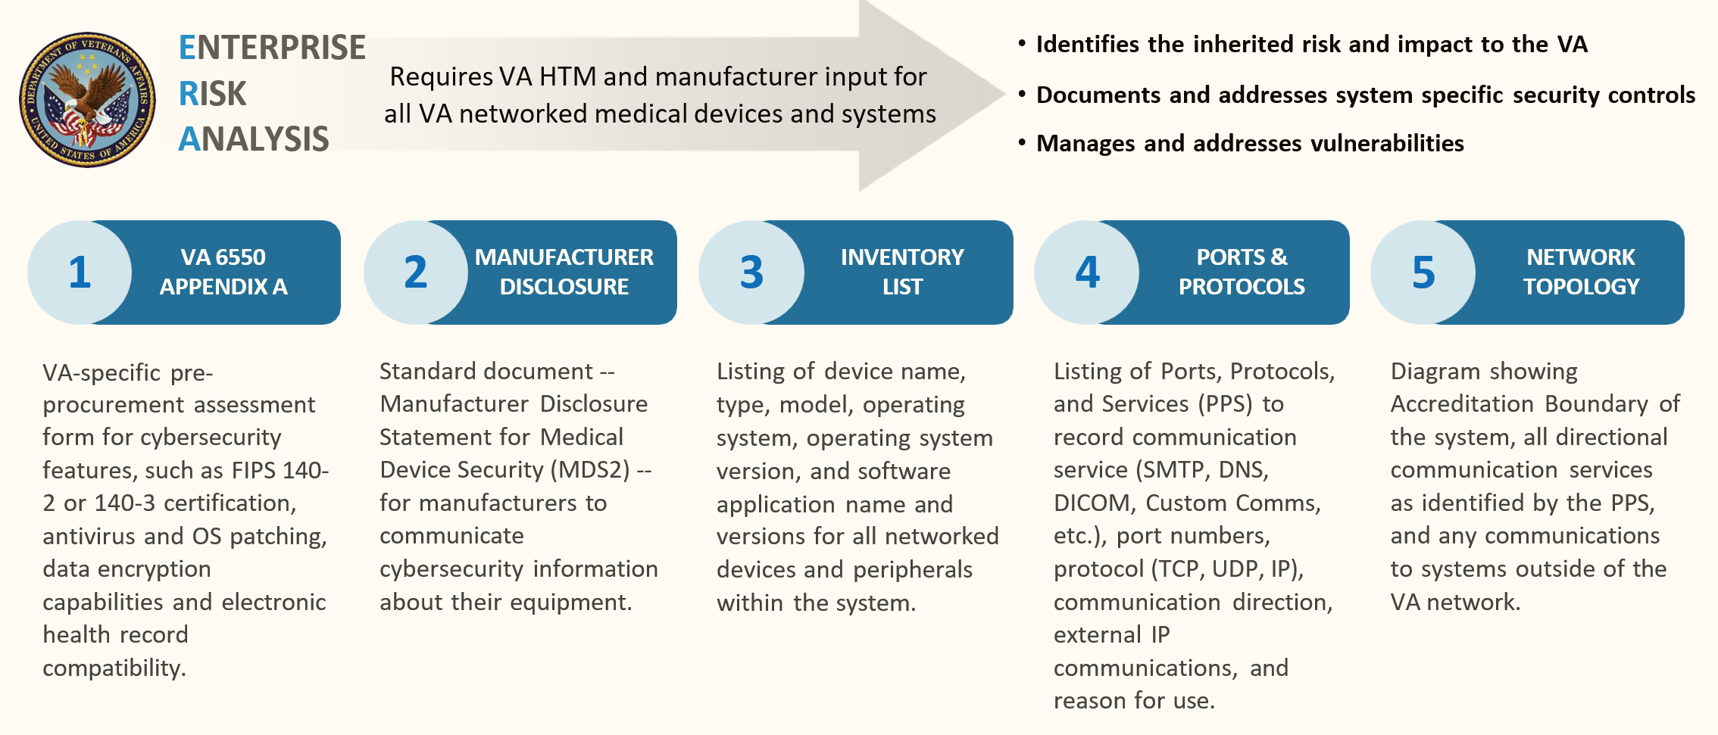
Enterprise Risk Analysis

Slide 83
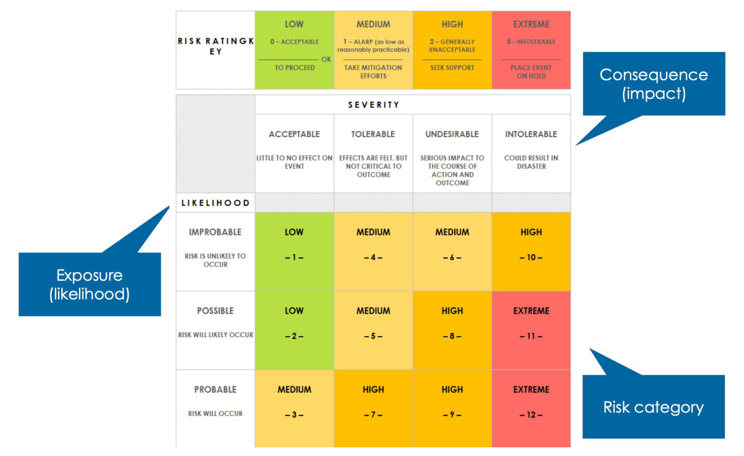
Cybersecurity Risk Management Matrix
Impact Considerations
Patient Harm
Severity of Harm
Number of Patients
Care Disruption
Type of Care
Criticality of Care
Duration
Blast Radius
Privacy Compromise
Type of Data
Number of Patients
Malicious Intent
Other:
Redundancy
Operational isolation

Slide 84

Examples: Risk Assessment
Phishing email
Software vulnerability
Case Study

Slide 85
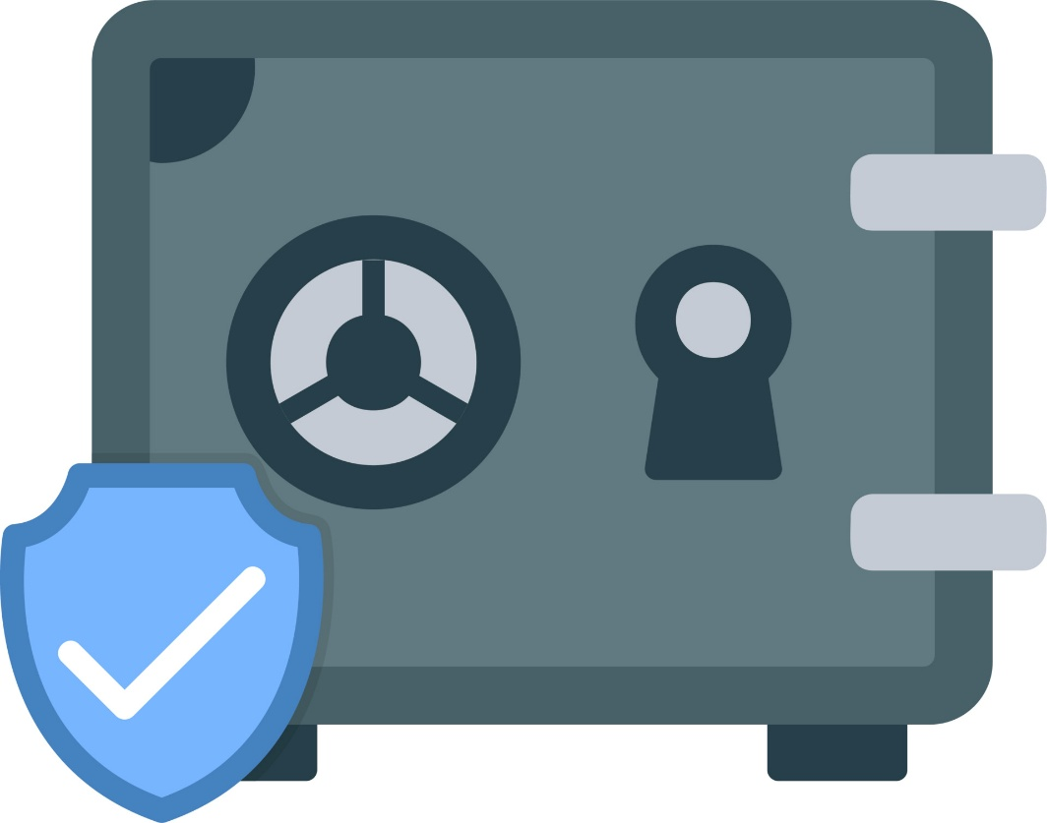
Identify Assets and Prioritize
Identify and focus efforts and resources on protecting the organization's most valuable and sensitive information

Slide 86
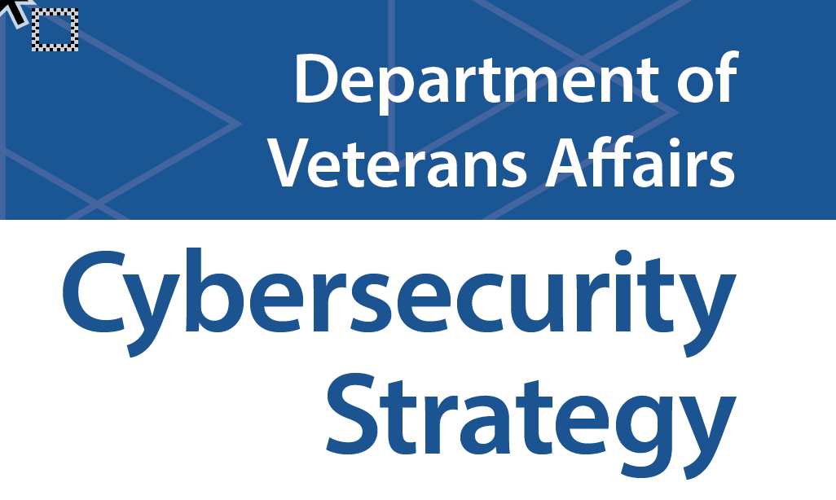
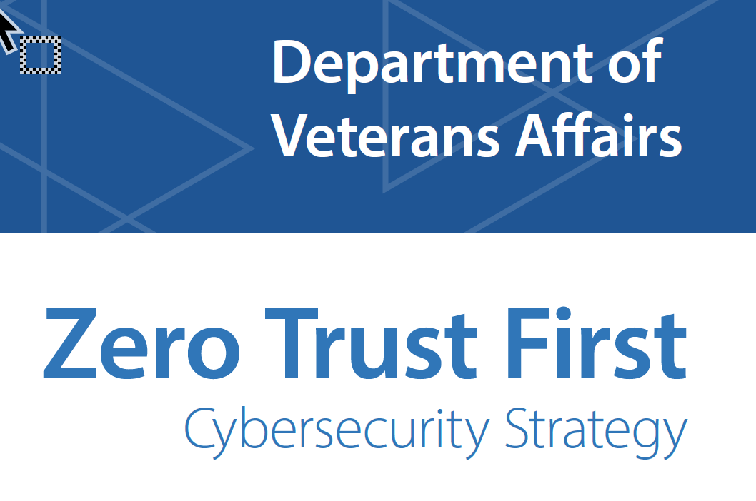
Set Objectives and Goals
Define clear and measurable cybersecurity objectives and goals that align with the organization's overall business strategy

Slide 87
Develop Policies and Procedures
Establish guidelines for employees, contractors, and third-party vendors to follow. These policies should cover areas such as data handling, password management, access controls, and incident response protocols

Slide 88
Administrative Mitigations
Prevent Weak Passwords
Use Multifactor identification
Institute Role based and least privilege-based administration
Change default credentials
Minimize the impact of phishing

Slide 89
Example: Administrative Mitigations
Key Requirements
Define device security properties
Standards alignment (encryption, security framework compliance, …)
Vendor security processes and secure development lifecycle
Network security
Physical security
Malware protection and maintenance
Resilience and recovery
Logging and auditability
Security documentation
Security maintenance (patches)
End-of-Support horizon and communication
Security communication
Security support
Remote / local access management
Data hosting
Decommissioning
https://healthsectorcouncil.org/wp-content/uploads/2025/11/MC2v2.pdf

Slide 90
Technical Mitigations
Firewalls
Regular updates and patches
System hardening
Compensating controls for legacy devices
Strong encryption
Resource
  OWASP Cheat Sheets

Slide 91
Example: Technical Mitigations
Network
Separation and Isolation
Segmentation / Micro-Segmentation / VLAN / Software-Defined Networks (SDN)
VPN for remote access
Network security monitoring (incl. PNM, discussed later)
  Note – older devices may not support modern routing protocols
Device
Implement secure version of respective communication protocols (secure DICOM, HL7 FHIR, etc.)
Secure data at rest
  Note – older devices may become the lowest common security denominator
  Note – adds complexity, e.g., cryptographic key management / PKI
Other options
Dedicated firewalls (but can be costly)
Removeable media controls (e.g., USB drives)
Access control and strong authentication (where possible)

Slide 92
Security Audits – Internal vs. External
Internal Audits (The Self-Check)
  Internal audits are conducted by the organization’s own staff (or a hired team reporting directly to management).
  Primary Objective: To identify gaps and improve security posture before a formal review.
  Scope: Often broader; can focus on operational efficiency as much as security.
  Reporting: Results are shared internally with stakeholders and management.
  Key Value: Acts as an early warning system and as preparation for an external audit.

Slide 93
Security Audits – Internal vs. External
External Audits (The Validation)
  External audits are performed by an independent third party (like the OIG, GAO, or a specialized security firm).
  Primary Objective: To provide an unbiased, independent opinion on whether the organization is meeting specific standards (e.g., VA Directive 6500 or FISMA).
  Scope: Usually focused on specific compliance frameworks or regulatory requirements.
  Key Value: Provides due diligence and high-level accountability. It proves to the public and the government that the VA is actually doing what it says it is doing.

Slide 94
Security Audits – Types
Two main types of Audits:
Incoming Inspection
Periodic Sampling
Assess relative to purchasing security requirements
Review security documentation
Vulnerability scan (identify exposed vulns; evaluate scanabillity)
Test network installation and technical evaluation
Check for malware
Pen testing
Check for currency of device information in inventory system (e.g., version, patch level)
Check for unauthorized configuration changes
Check for unauthorized connectivity
Scan for vulnerabilities
Assess for compromise:
  Malware
  Event logs

Slide 95
Module 4 Objectives
Understand the purpose and processes involved in vulnerability
Discuss the common methods for vulnerability scanning
Explore common tools for automated vulnerability testing
Understanding how to interpret a vulnerability testing report

Slide 96
Vulnerability Assessments
Proactive risk identification
Prioritization of resources (triage)
Validation of security controls
Maintaining authority to operate (ATO)

Slide 97
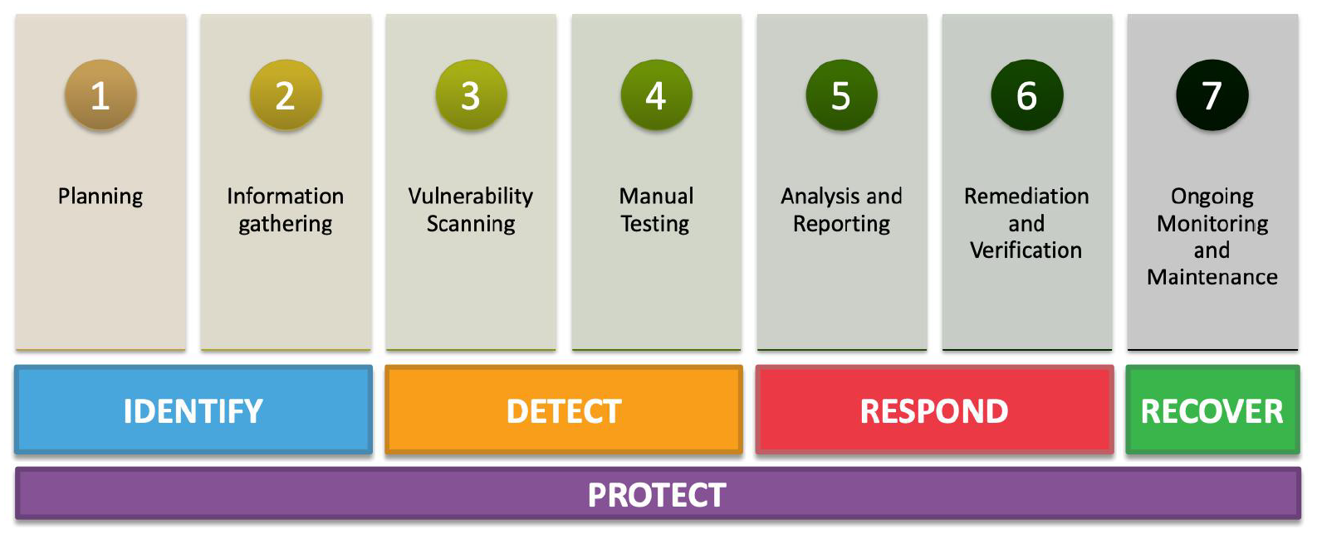
Vulnerability Assessments - Steps

Slide 98
Vulnerability Assessments – Medical Devices
Follow generally established best practices but consider special medical device needs:
Not all devices are network-discoverable or -scannable
  May fail to respond
  May react unfavorably (e.g., reboot)
Include all components of the medical device system:
  E.g., patient monitors, central station, backend server, cloud service, network gear
  Understand that some devices or supporting components may have special configuration requirements that may deviate from IT standards
Assessment depth may vary but may include full pen test and security evaluation
Coordinate across stakeholders (Clinical Eng., IT/ITSec, clinical)
Document findings, resolutions, and approved exceptions

Slide 99
Step 1: Planning
Define objectives
Identify scope
Establish test criteria
Develop test plan

Slide 100
Step 2: Information Gathering
Network infrastructure
Operating systems
Applications and services
Open ports and services
Credentials and access
Regulatory and compliance requirements

Slide 101
Step 3: Vulnerability Scanning
Internal scanning
External scanning
Penetration testing
Wireless network testing
Web application testing
Social engineering assessments

Slide 102
Step 3: Vulnerability Scanning Tools
Kali Linux
  Pen testing tools
  Forensics and data recovery
  Wireless network auditing
  Web application testing
  Social engineering
  Password attacks
  Security scanning
  Privacy and anonymity

Slide 103

Step 3: Vulnerability Scanning Tools
Metasploitable 2
  Intentionally Insecure: Unlike a standard Linux server, it is configured with dozens of "weaknesses" out of the box. This includes old versions of software, weak passwords, and misconfigured services.
  Target Practice: It is designed to be used as a target for tools like Nmap (for scanning), Nessus (for vulnerability assessment), and Metasploit (for exploitation).
  Local & Safe: Because it is a Virtual Machine, students can hack it on their own laptop or a private lab network without breaking any laws or risking real-world systems.

Slide 104

Step 3: Vulnerability Scanning Tools
Metasploit Framework
  Massive Exploit Database: Provides a constantly updated library of thousands of "keys" to open doors in nearly every operating system and hardware type.
  Payload Gallery: Offers a diverse set of post-breach actions, ranging from simple command shells to advanced, memory-resident tools like Meterpreter.
  Post-Exploitation Modules: Enables "pivoting" and privilege escalation to move deeper into a network and gain administrative control after the initial entry.
  Vulnerability Scanner Integration: Allows you to import data from tools like Nessus or Nmap to automatically target confirmed weaknesses.
  MSFvenom (Payload Generator): Creates and encodes custom "malicious" files (like .exe or .ps1) specifically designed to test and bypass Antivirus defenses.

Slide 105
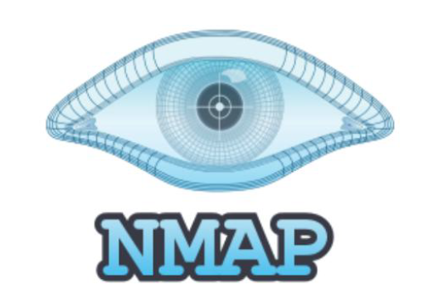
Step 3: Vulnerability Scanning Tools
Nmap
  Host Discovery: Efficiently identifies which devices are "alive" on a network by using various ping and packet techniques to map the active attack surface.
  Port Scanning: Probes thousands of TCP and UDP ports to determine if they are Open, Closed, or Filtered by a firewall.
  Service and Version Detection: Interrogates open ports to identify specific software names and version numbers, which is essential for finding matching exploits.
  OS Fingerprinting: Analyzes network response patterns to accurately guess the target's operating system (e.g., Windows, Linux, or a specific version of Cisco IOS).
  Nmap Scripting Engine (NSE): Uses a powerful library of over 600 scripts to automate complex tasks like vulnerability detection, malware discovery, and advanced reconnaissance.

Slide 106
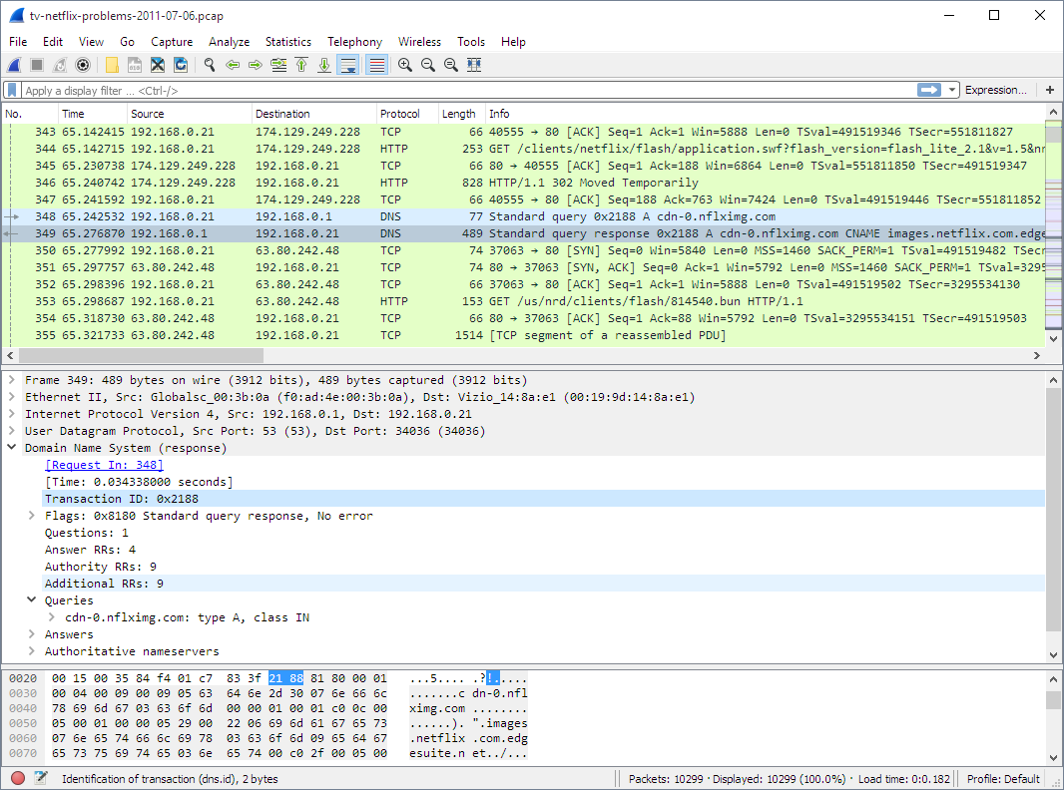
Step 3: Vulnerability Scanning Tools
Wireshark
  Troubleshooting: Identifies why a network is slow or an application is failing.
  Security & Forensics: Detects malware "beacons" and unauthorized data theft.
  Protocol Debugging: Validates that new software sends data packets correctly.
  Education: Visualizes the TCP Three-Way Handshake and the OSI model.
  Optimization: Pinpoints bandwidth "hogs" and unnecessary network chatter.

Slide 107





Step 3: Vulnerability Scanning Tools
BurpSuite – Web application security
Aircrack-ng – Monitor and analyze wireless networks
Nessus – Vulnerability scanning using CVE architecture
John the Ripper – Password cracking
THC Hydra – Password cracking

Slide 108
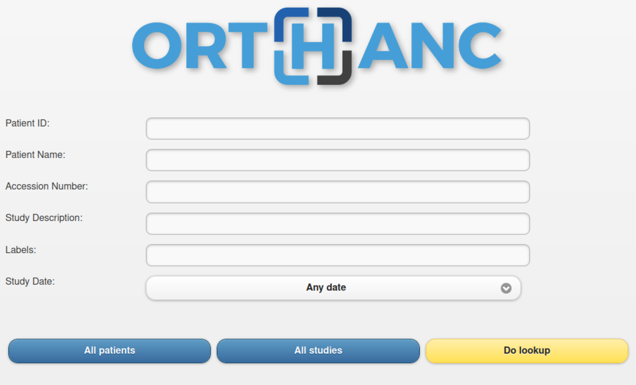
Lab 3 & 4 – DICOM Vulnerabilities

Slide 109
Step 4: Manual Testing
Plan on periodic security testing because:
  Devices change (e.g., patches, although well intended, may introduce new vulnerabilities)
  Network integration, technical environment, and use cases change
  New threats and vulnerabilities are discovered regularly
General guidance:
  Devices should be tested when not in use (sorry for sating the obvious)
  Be weary of network-based tests of medical devices
  Test identifies new security risks but also device response to test
  Ideally, test in an isolated test network environment, not in production
Types and methods of testing:
  Vulnerability scanning (but, as already discussed, many esp. older devices may not support)
  Interface testing (protocol emulation, fuzz testing, …)
  Pen testing by an experienced tester
Closure:
  Document
  Prioritize and take action based on identified risk
  Share findings and concerns with manufacturer

Slide 110

Step 4: Manual Testing
Red team vs. Blue team
  Red Team: Acts as the adversary to identify and exploit vulnerabilities by simulating real-world cyberattacks against an organization's defenses.
  Blue Team: Acts as the internal defender to monitor, detect, and respond to security threats while maintaining and hardening the network's protective controls.

Slide 111
Step 5: Analysis
Analysis (Filtering the Noise)
  Risk Prioritization: Uses CVSS scores to rank vulnerabilities so the most dangerous threats are fixed first.
  Contextual Validation: Distinguishes between a "Critical" bug on a public server versus a low-risk internal device.
  False Positive Removal: Manually verifies scan data to ensure IT staff don't waste time on "ghost" vulnerabilities.

Slide 112
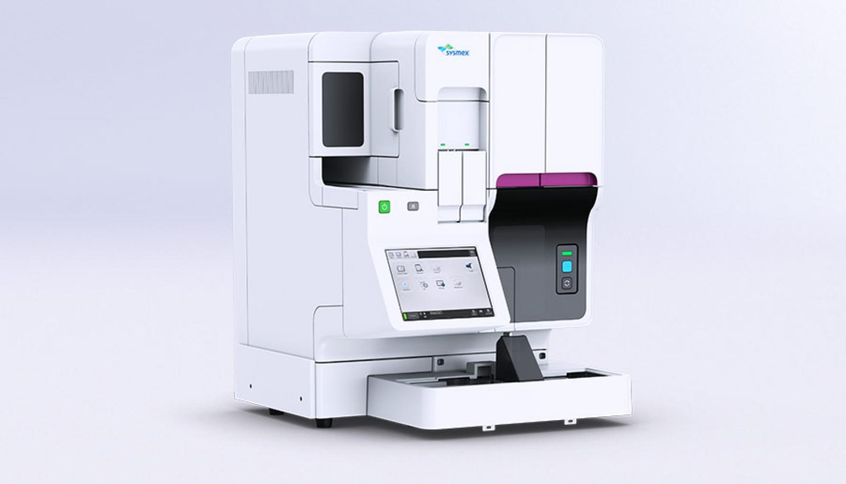
Lab 5 – Security Audit

Slide 113
Step 5: Reporting
Reporting (Communicating Action)
  Executive Summary: Provides high-level risk trends and compliance status (e.g., FISMA/HIPAA) for management.
  Technical Roadmap: Delivers specific CVE numbers and patch links to SysAdmins for immediate remediation.
  Audit Trail: Creates a formal record of security posture required for legal and regulatory "due diligence."

Slide 114
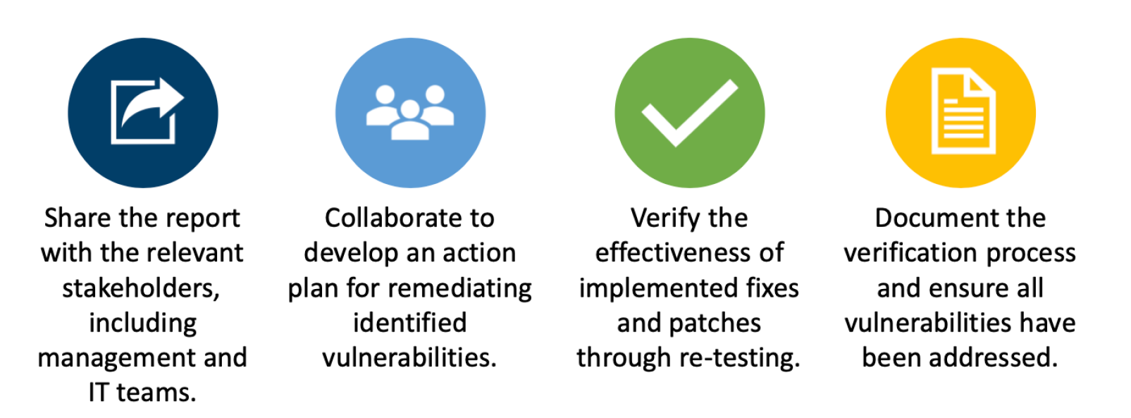
Step 6: Remediation and Verification

Slide 115







Step 7: Ongoing Monitoring & Maintenance
Medical Device Network
Imaging Network
SPAN/TAP
connection
Integration with:
Asset management (CMMS/CMDB)
Risk tools
IT Security tools
External sources:
Recalls and advisories
Vulnerability disclosure
Manufacturer security data (e.g., MDS2)
Community-derived
Filter
Analysis
Provides:
Pre-procurement assessment
Supply chain risk mgmt.
Recall management
Security best practices
Traffic analysis
Behavior baseline
Security event detection
Usage & network statistics
Vulnerability identification
Risk remediation prioritization
Knowledge Base
Alerts
Passive Network Monitoring (PNM) Solution
Notes:
Mention that Passive Network Monitoring is a security technology (and corresponding commercial products) that overcomes some of the problems of active scanning that is more common on the IT side. Products have been around for a number of years now and have developed a mature set of features going beyond just network-based event detection (as listed above).

Slide 116

Step 7: Ongoing Monitoring & Maintenance
Maintenance activities as a result of:
  Performed testing
  Observed incidents
  Manufacturer communication
  Security communication (FDA, CISA, ISAC, …)
Scale response based on risk and control appropriateness:
  Isolate / segment off
  Patch as soon as available
  Patch at next periodic maintenance
  Remove from service / replace

Slide 117
Employee Training and Awareness
Conduct regular cybersecurity training and awareness programs for all employees to educate them about potential threats, phishing scams, and safe computing practices.
Research shows that the human element still makes up the overwhelming majority of incidents and is a factor in 74% of total breaches.
Source: https://www.forbes.com/sites/forbestechcouncil/2023/07/25/why-employees-are-a-crucial-part-of-your-cybersecurity-strategy/?sh=29ce32285cc8

Slide 118
Intermediate Cybersecurity Review

Slide 119
HTM214: Intermediate Cybersecurity

